Slide 1
Advancing Kidney Health Worldwide. Together.

Slide 2
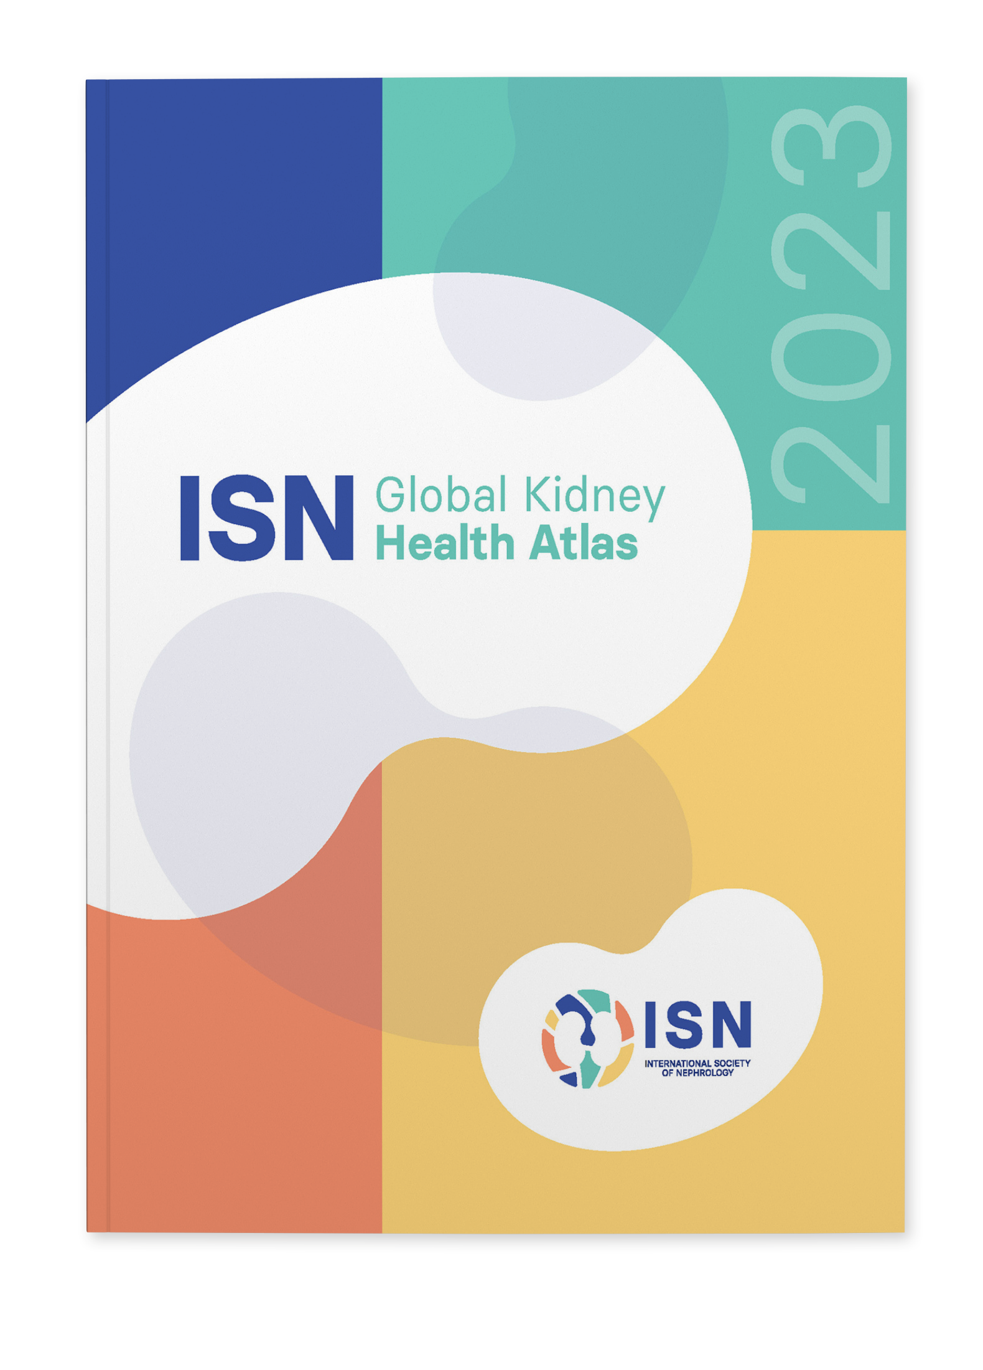
2023 ISN-GLOBAL KIDNEY HEALTH ATLAS (ISN-GKHA) ISN WESTERN EUROPE REGION
www.theisn.org/global-atlas

Slide 3

Overview
Aim
Methods
Key Results

Slide 4
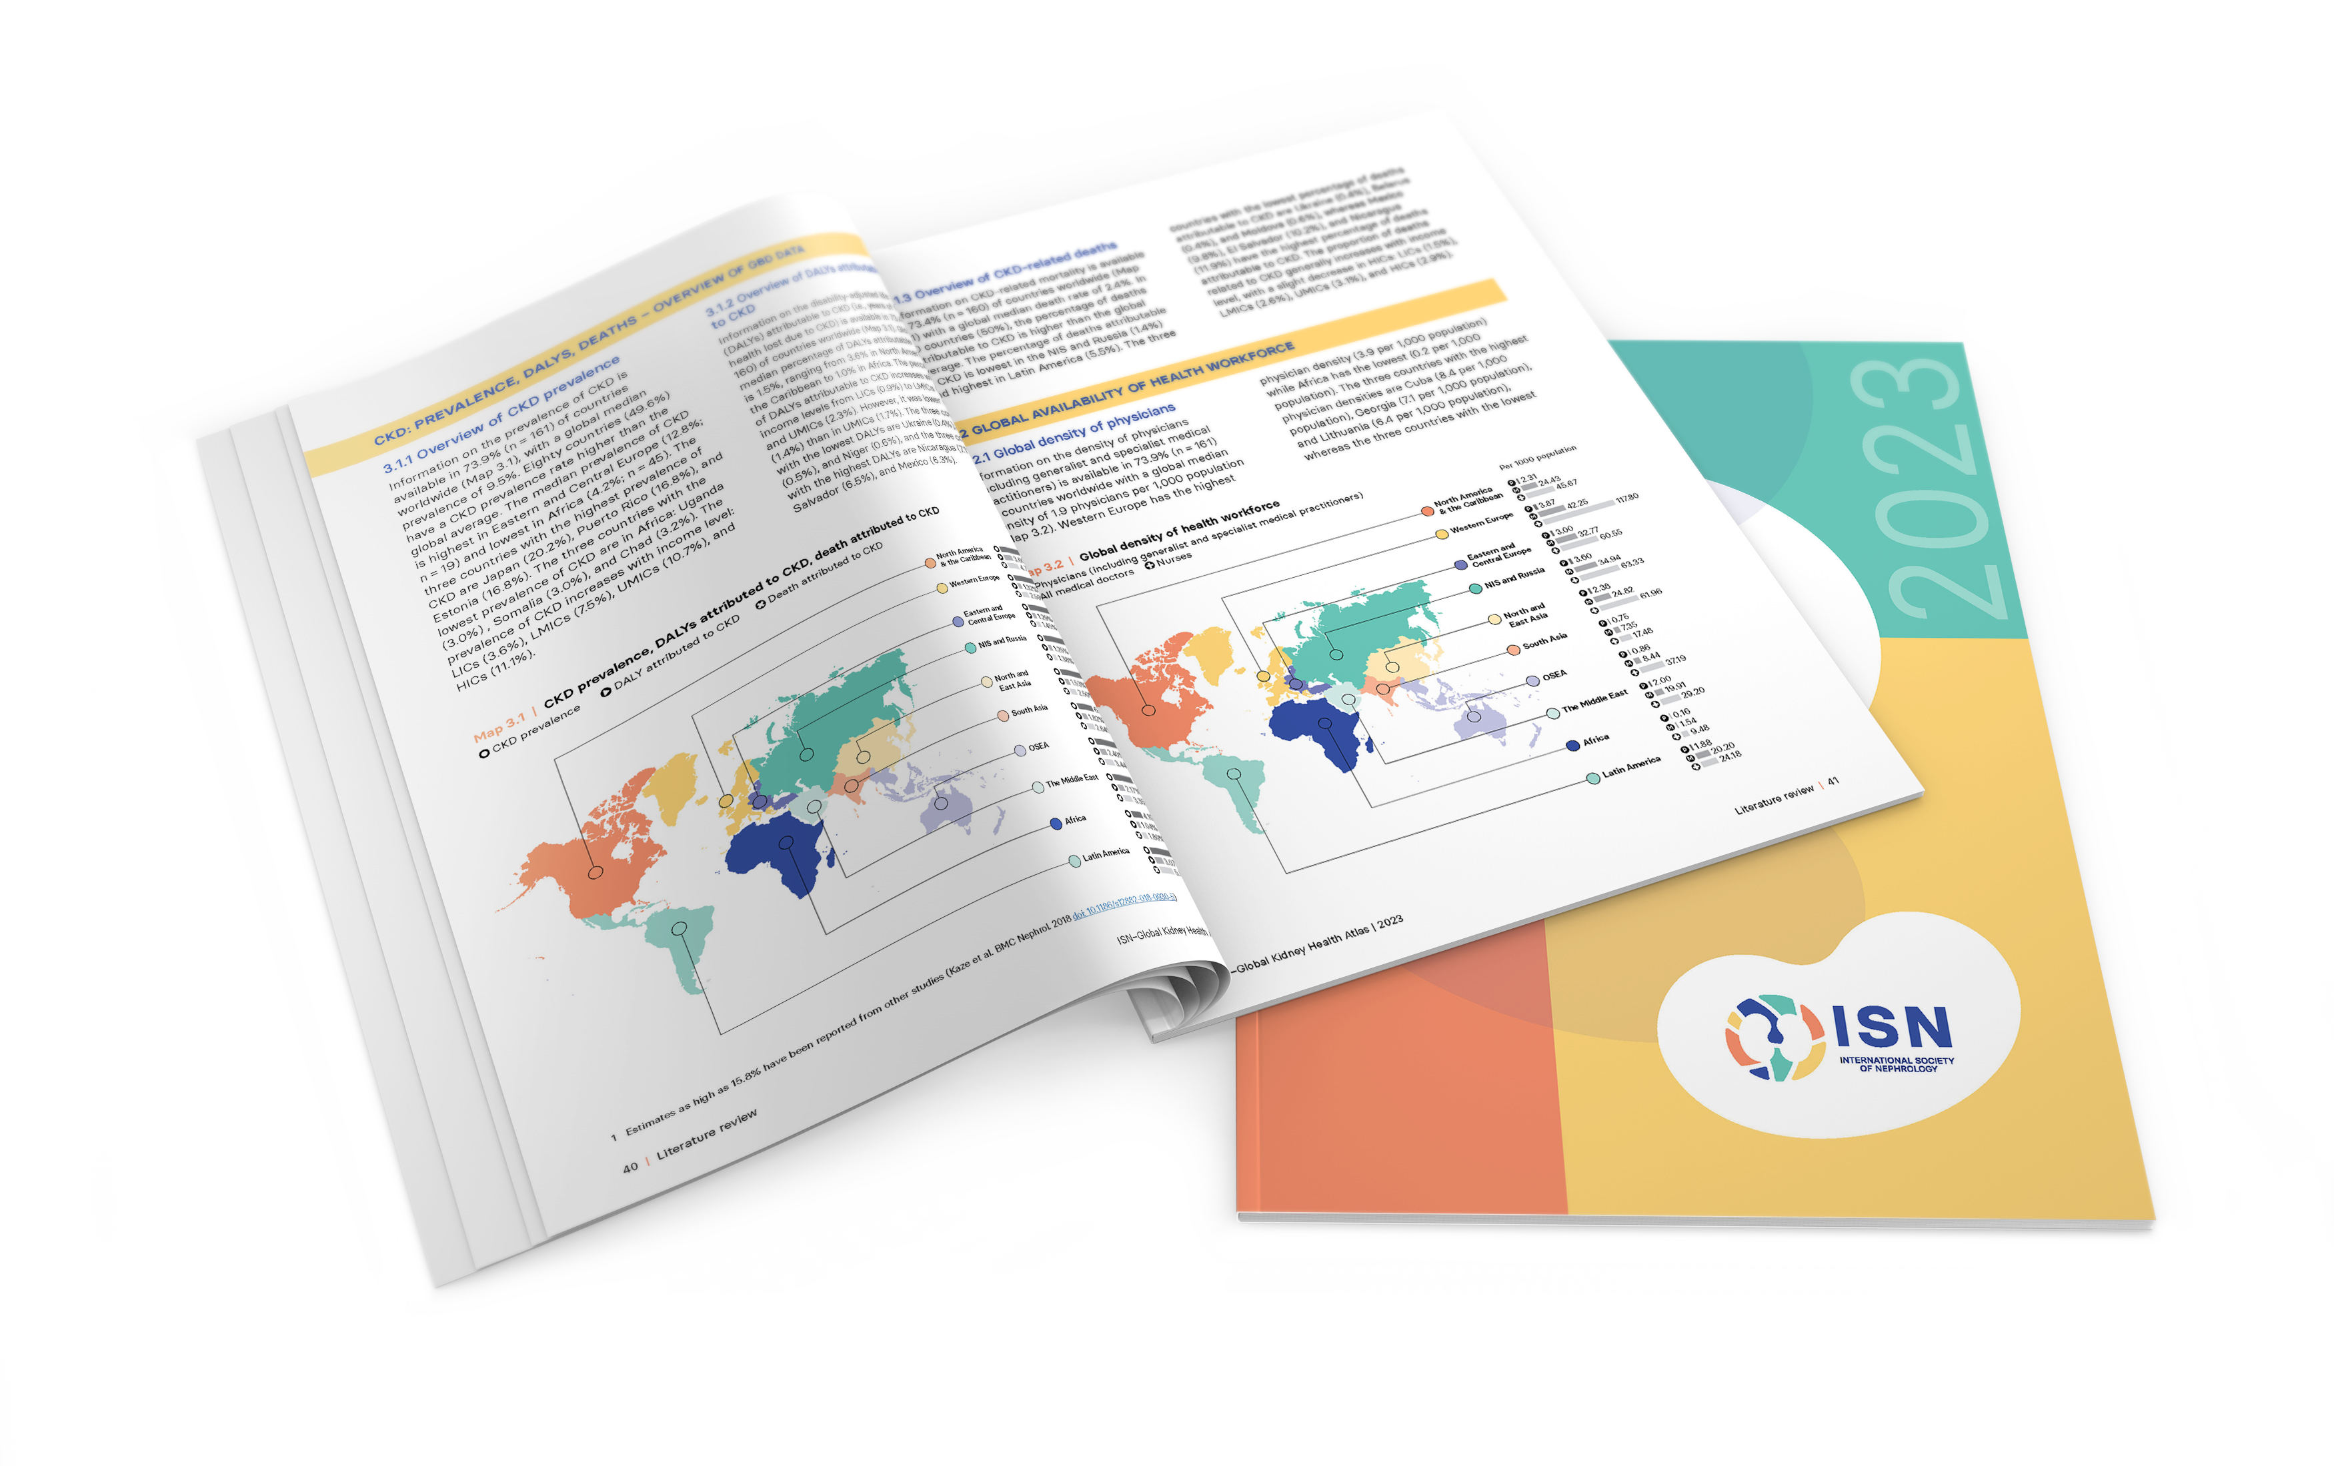
Aim of the ISN-Global Kidney Health Atlas
To understand, compare and monitor how different countries around the world detect, treat, monitor and advocate for people with kidney disease (AKI or CKD).
Key focus on availability, accessibility, affordability and quality of ESKD care

Slide 5
ISN-Global Kidney Health Atlas Survey
2016
2018
2022
2026

Slide 6
Design and Scope
Online questionnary-based survey July – September 2022
3 languages (English, French, Spanish)
191 countries contacted
≥3 stakeholders per country
National nephrology society leadership
Healthcare policymakers
Patients / patient advocacy groups
Discrepancies resolved by follow-up conferences with regional board chairs and country nephrology leaders
Desk research (across countries and regions)
Published and grey literature review
Systematic review of kidney failure burden and outcomes
Data extraction from major kidney registries (USRDS, ERA-EDTA) and relevant national registries where available
Scoping review of KRT cost estimates
Notes:
REDCap Cloud. The questionnaire was peer reviewed for content validity and comprehensiveness before it was piloted with the 10 ISN regional boards to identify any logistical and feasibility issues (e.g., translation needs). Intensive follow-ups were conducted by email and telephone with ISN regional and national leaders to ensure complete and timely responses.
Data and reports published by the WHO Global Observatory, UN, World Bank, and OECD.
Both published and unpublished documents from international organizations/bodies and reports published by national governments on the organization and
delivery of ESKD.
Additional literature identified by key stakeholders (i.e., opinion leaders, national nephrology society leaders, ISN leaders) and through consultation with national nephrology societies and ISN regional boards.

Slide 7
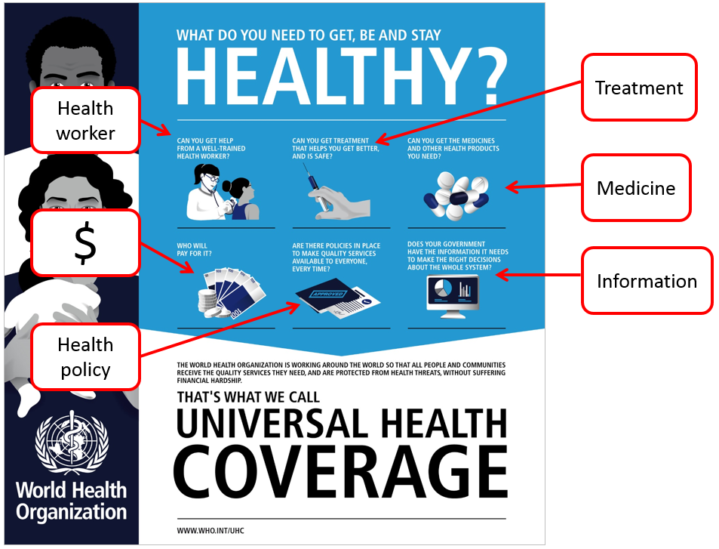
Overall Survey Components

Slide 8
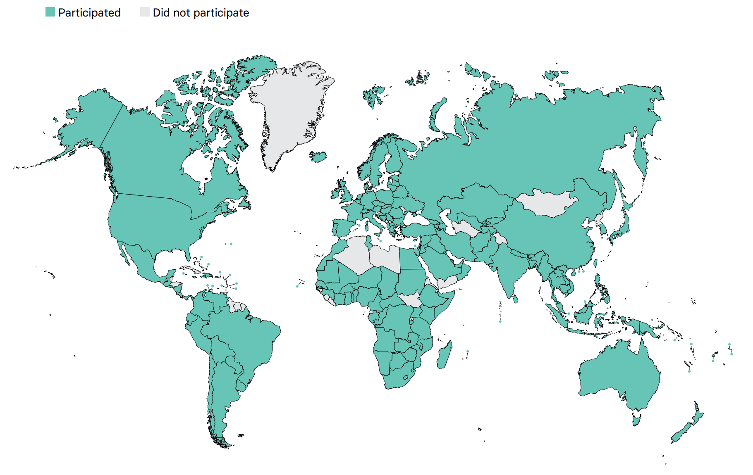
Overall ISN-GKHA response
167 countries (92%)
97% world’s population
329 individuals (63%) response
2 respondents/country (IQR 2-3)
108 countries participated in the 2017, 2019, and 2023 GKHA surveys

Slide 9
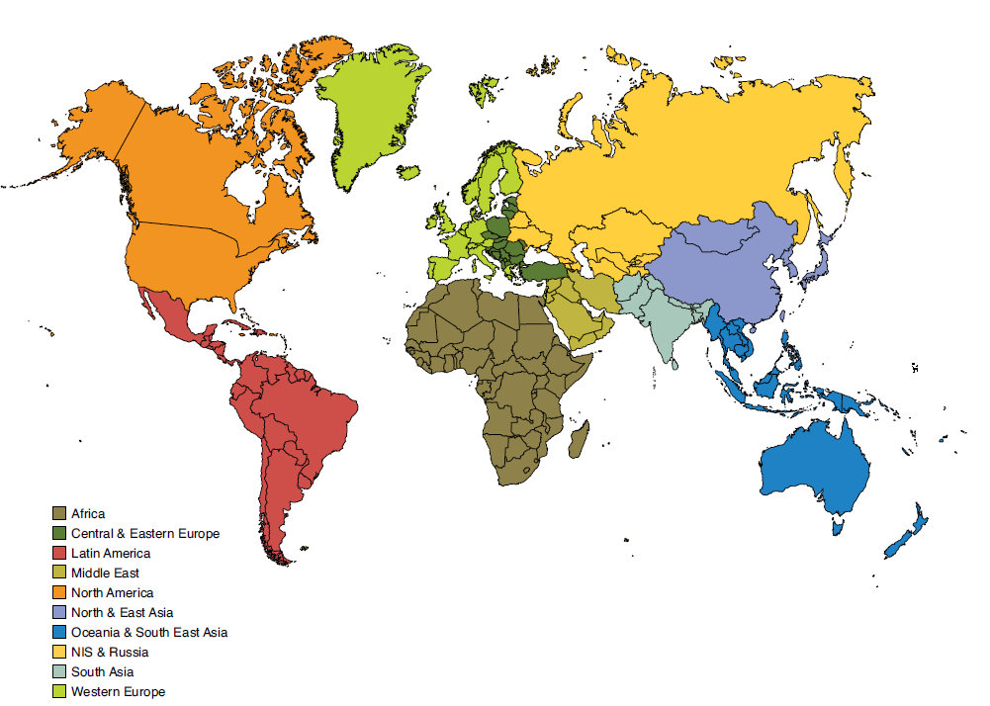
Results presented by ISN regions

Slide 10

ISN Region: Western Europe

Slide 11
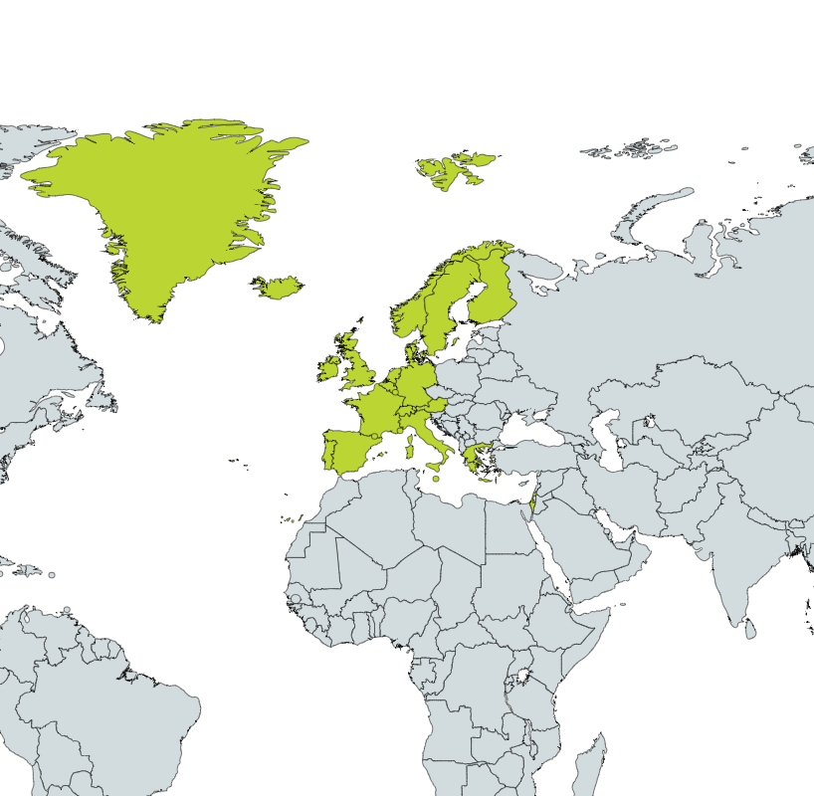
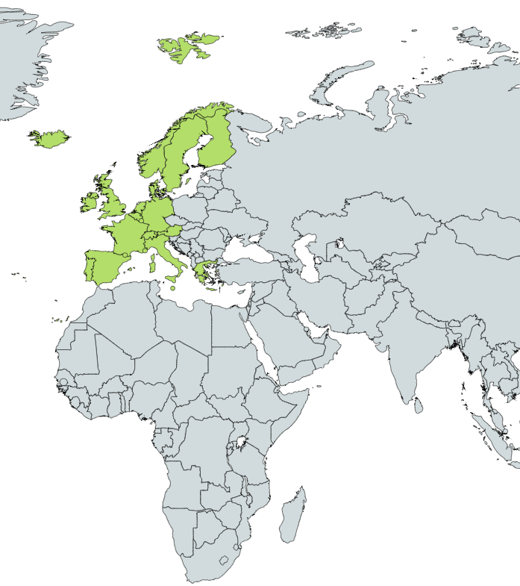
Demographics
Country | World bank ranking | Area (sq km) | Total population (2022) | GDP (PPP) ($ billion) | Total health expenditures (% of GDP)
Andorra | High income | 468 | 85,560 | 3.3 | 6.7
Austria | High income | 83,871 | 8,913,088 | 523.3 | 10.4
Belgium | High income | 30,528 | 11,847,338 | 682.9 | 10.7
Denmark | High income | 43,094 | 5,920,767 | 378.6 | 10
Finland | High income | 357,022 | 5,601,547 | 304.8 | 9.2
France | High income | 643,801 | 68,305,148 | 3424.2 | 11.1
Germany | High income | 357,022 | 84,316,622 | 4815.5 | 11.7
Greece | High income | 131,957 | 10,533,871 | 333.7 | 7.8
Iceland | High income | 572 | 357,603 | 21.5 | 8.6
Ireland | High income | 70,723 | 5,275,004 | 535.3 | 6.7
Israel | High income | 20,770 | 8,914,885 | 409.4 | 7.5
Italy | High income | 2,586 | 61,095,551 | 2713.3 | 8.7
Liechtenstein | High income | 160 | 39,711 | 5.0 | NA
Luxembourg | High income | 2,586 | 650,364 | 86.1 | 5.4
Malta | High income | 316 | 464,186 | 25.2 | 8.2
Netherlands | High income | 41,543 | 17,400,824 | 1118.1 | 10.1
Norway | High income | 323,802 | 5,553,840 | 428.3 | 10.5
Portugal | High income | 450,295 | 10,242,081 | 369.6 | 9.5
Spain | High income | 505,370 | 47,163,418 | 1929.8 | 9.1
Sweden | High income | 450,295 | 10,483,647 | 617.9 | 10.9
Switzerland | High income | 41,277 | 8,508,698 | 672.5 | 11.3
United Kingdom | High income | 243,610 | 67,791,400 | 3344.5 | 10.2
Responses were received from 22 of 29 countries in Western Europe (75.9%) representing 99% of the region’s population.
‘ – ’ : data not reported/unavailable

Slide 12
Demographics
Country | World bank ranking | Area (sq km) | Total population (2022) | GDP (PPP) ($ billion) | Total health expenditures (% of GDP) | Total Health Spending per person | Government Health Spending per person | Out-of-pocket Health Spending per person
Andorra | High income | 468 | 85,560 | 3.3 | 6.7 | 2875 | 1993 | 358
Austria | High income | 83,871 | 8,913,088 | 523.3 | 10.4 | 5721 | 4361 | 907
Belgium | High income | 30,528 | 11,847,338 | 682.9 | 10.7 | 5088 | 3998 | 848
Denmark | High income | 43,094 | 5,920,767 | 378.6 | 10 | 6300 | 5392 | 767
Finland | High income | 357,022 | 5,601,547 | 304.8 | 9.2 | 4553 | 3666 | 755
France | High income | 643,801 | 68,305,148 | 3424.2 | 11.1 | 4838 | 3629 | 403
Germany | High income | 357,022 | 84,316,622 | 4815.5 | 11.7 | 5838 | 4701 | 627
Greece | High income | 131,957 | 10,533,871 | 333.7 | 7.8 | 1599 | 909 | 514
Iceland | High income | 572 | 357,603 | 21.5 | 8.6 | 5670 | 4779 | 800
Ireland | High income | 70,723 | 5,275,004 | 535.3 | 6.7 | 6128 | 4690 | 637
Israel | High income | 20,770 | 8,914,885 | 409.4 | 7.5 | 3259 | 2241 | 627
Italy | High income | 2,586 | 61,095,551 | 2713.3 | 8.7 | 3205 | 2491 | 640
Liechtenstein | High income | 160 | 39,711 | 5.0 | NA | - | - | -
Luxembourg | High income | 2,586 | 650,364 | 86.1 | 5.4 | 6782 | 5976 | 609
Malta | High income | 316 | 464,186 | 25.2 | 8.2 | 3553 | 2470 | 1013
Netherlands | High income | 41,543 | 17,400,824 | 1118.1 | 10.1 | 5621 | 3798 | 535
Norway | High income | 323,802 | 5,553,840 | 428.3 | 10.5 | 7254 | 6300 | 929
Portugal | High income | 450,295 | 10,242,081 | 369.6 | 9.5 | 2230 | 1446 | 589
Spain | High income | 505,370 | 47,163,418 | 1929.8 | 9.1 | 3001 | 2246 | 556
Sweden | High income | 450,295 | 10,483,647 | 617.9 | 10.9 | 5851 | 5046 | 740
Switzerland | High income | 41,277 | 8,508,698 | 672.5 | 11.3 | 9801 | 3290 | 2532
United Kingdom | High income | 243,610 | 67,791,400 | 3344.5 | 10.2 | 4903 | 4093 | 625
‘ – ’ : data not reported/unavailable

Slide 13
CKD and its risk factors burden
Country | CKD Prevalence % (95% CI) | Death attributed to CKD % (95% CI) | DALYS attributed to CKD % (95% CI) | Obesity % (95% CI) | Increased BP % (95% CI) | Smoking % (95% CI)
Andorra | 9.17 (8.48 - 9.80) | 2.59 (2.19 - 2.94) | 1.19 (1.01 - 1.36) | 28.0 (22.0 - 34.0) | 18.7 (13.3 - 24.8) | 20.6 (18.1 - 23.0)
Austria | 11.57 (10.73 - 12.38) | 4.08 (3.47 - 4.51) | 1.85 (1.61 - 2.09) | 21.9 (17.5 - 26.8) | 21.0 (15.7 - 27.1) | 25.2 (22.8 - 27.8)
Belgium | 11.00 (10.28 - 11.70) | 2.6 (2.2 - 2.92) | 1.33 (1.15 - 1.49) | 24.5 (20.7 - 28.5) | 17.5 (12.9 - 23.0) | 18.7 (17.0 - 20.4)
Denmark | 10.63 (9.86 - 11.37) | 2.05 (1.77 - 2.26) | 1.23 (1.08 - 1.38) | 21.3 (17.5 - 25.3) | 20.6 (15.9 - 25.7) | 17.5 (16.0 - 19.1)
Finland | 10.22 (9.50 - 10.89) | 1.26 (1.06 - 1.4) | 0.77 (0.68 - 0.86) | 24.9 (21.2 - 28.7) | 19.4 (15.2 - 24.1) | 16.8 (15.2 - 18.6)
France | 10.49 (9.77 - 11.28) | 2.11 (1.71 - 2.42) | 1.09 (0.94 - 1.24) | 23.2 (18.8 - 27.8) | 22.0 (16.6 - 27.8) | 21.4 (19.3 - 23.4)
Germany | 12.27 (11.57 - 12.96) | 3.67 (3.15 - 4.06) | 1.8 (1.57 - 2.02) | 25.7 (21.9 - 29.8) | 19.9 (14.7 - 25.1) | 21.2 (19.2 - 23.3)
Greece | 14.67 (12.73 - 16.91) | 3.58 (3.13 - 3.97) | 2.1 (1.85 - 2.36) | 27.4 (22.5 - 32.7) | 19.1 (13.8 - 25.3) | 31.2 (28.9 - 33.5)
Iceland | 7.99 (7.44 - 8.56) | 1.58 (1.32 - 1.78) | 0.81 (0.7 - 0.92) | 23.1 (19.1 - 27.4) | 19.7 (14.1 - 25.9) | 14.7 (12.9 - 16.5)
Ireland | 9.59 (9.17 - 10.04) | 2.16 (1.85 - 2.43) | 1.08 (0.94 - 1.23) | 26.9 (22.3 - 31.7) | 19.7 (14.7 - 25.3) | 21.6 (19.2 - 24.2)
Israel | 8.45 (7.86 - 9.05) | 5.77 (4.95 - 6.37) | 2.45 (2.1 - 2.83) | 26.7 (21.9 - 31.6) | 16.6 (11.7 - 22.4) | 17.8 (15.9 - 20.0)
Italy | 12.17 (11.30 - 13.06) | 2.57 (2.16 - 2.81) | 1.39 (1.21 - 1.55) | 22.9 (19.3 - 26.8) | 21.2 (16.2 - 26.3) | 19.4 (17.7 - 21.4)
Liechtenstein | - | - | - | - | - | -
Luxembourg | 9.84 (9.16 - 10.53) | 2.87 (2.43 - 3.22) | 1.32 (1.14 - 1.49) | 24.2 (19.4 - 29.4) | 21.9 (16.3 - 27.9) | 20.9 (18.4 - 23.6)
Malta | 11.91 (11.03 - 12.77) | 2.79 (2.39 - 3.12) | 1.59 (1.38 - 1.8) | 31.0 (25.1 - 37.0) | 19.4 (13.8 - 25.5) | 18.8 (16.6 - 20.9)
Netherlands | 11.26 (10.47 - 12.05) | 2.41 (2.06 - 2.69) | 1.24 (1.08 - 1.4) | 23.1 (19.3 - 27.0) | 18.7 (14.4 - 23.7) | 17.9 (16.2 - 19.5)
Norway | 8.82 (8.20 - 9.41) | 1.87 (1.61 - 2.03) | 0.97 (0.84 - 1.08) | 25.0 (20.9 - 29.2) | 19.7 (14.7 - 25.0) | 15.3 (13.6 - 17.2)
Portugal | 11.58 (10.63 - 12.55) | 3.5 (2.98 - 3.87) | 1.8 (1.56 - 2.04) | 23.2 (18.8 - 27.8) | 24.4 (18.2 - 31.2) | 17.8 (15.9 - 19.8)
Spain | 10.33 (9.57 - 11.10) | 3.42 (2.82 - 3.9) | 1.52 (1.3 - 1.74) | 27.1 (23.2 - 31.1) | 19.2 (14.5 - 24.6) | 21.8 (19.7 - 24.0)
Sweden | 11.14 (10.30 - 11.95) | 2.13 (1.8 - 2.35) | 1.13 (0.98 - 1.28) | 22.1 (18.3 - 26.0) | 19.3 (14.7 - 24.3) | 11.4 (10.7 - 12.2)
Switzerland | 11.44 (10.63 - 12.20) | 3.18 (2.63 - 3.62) | 1.36 (1.15 - 1.54) | 21.2 (17.3 - 25.3) | 18.0 (13.5 - 23.2) | 19.1 (17.1 - 21.3)
United Kingdom | 9.07 (8.43 - 9.72) | 1.25 (1.1 - 1.34) | 0.82 (0.72 - 0.9) | 29.5 (26.6 - 32.5) | 15.2 (12.2 - 18.3) | 18.7 (17.0 - 20.4)
Abbreviations: CKD (Chronic Kidney Disease), DALYS (disability-adjusted life years), BP (blood pressure), CI (confidence interval)
Data source: GBD study database (http://www.healthdata.org/gbd), WHO data observatory (https://www.who.int/gho/en/)
‘ – ’ : data not reported/unavailable

Slide 14
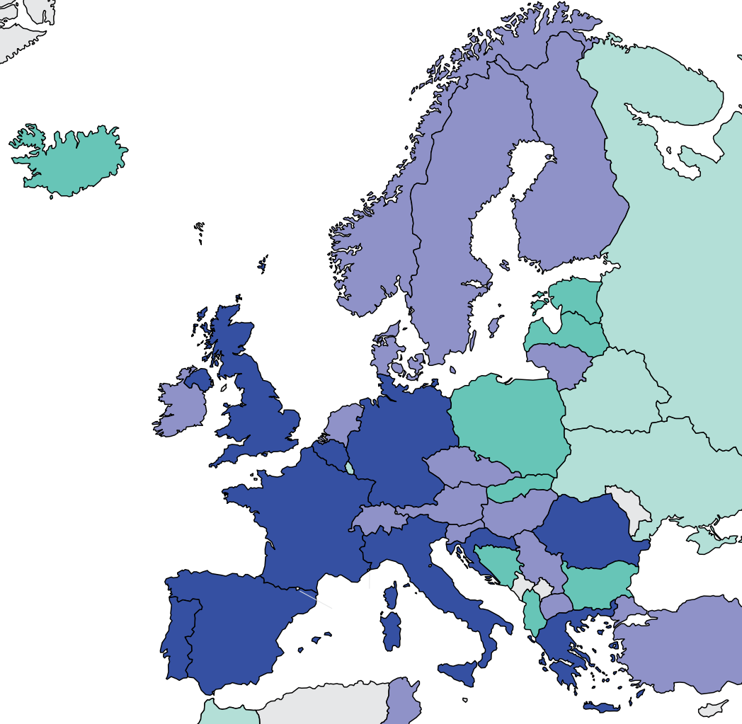
Burden of kidney failure
Country | Treated kidney failure |  | Chronic dialysis (HD+PD) |  | Chronic Hemodialysis |  | Chronic Peritoneal dialysis
 | Incidence | Prevalence | Incidence | Prevalence | Incidence | Prevalence | Incidence | Prevalence
Andorra | - | - | - | - | - | - | - | -
Austria | 135 | 1044 | 128.8 | 536.2 | 118.2 | 495.8 | 10.6 | 40.4
Belgium | 197 | 1337 | 194.2 | 766.15 | 175.85 | 708.65 | 18.35 | 57.5
Denmark | 108 | 952 | 97.9 | 434 | 61.8 | 346.8 | 36.1 | 87.2
Finland | 94 | 957 | 91.7 | 361 | 69.2 | 306.8 | 22.5 | 54.2
France | 170 | 1376 | 162.7 | 746.5 | 146.1 | 700.7 | 16.6 | 45.8
Germany | - | 1114 | - | 808 | - | 768.1 | - | 38.8
Greece | 269 | 1413 | 267.8 | 1164.4 | 255.1 | 1100.5 | 12.7 | 63.9
Iceland | 108 | 810 | 91.5 | 241.3 | 69.3 | 196.9 | 22.2 | 44.4
Ireland | 88 | 979 | - | 445 | - | 401.39 | - | 39.16
Israel | 198 | 755 | - | 756 | - | 698.32 | - | 62.35
Italy | 165 | 1276 | - | 800 | - | 701.8 | - | 89.32
Liechtenstein | - | - | - | - | - | - | - | -
Luxembourg | - | 522 | - | 87 | - | 596.7 | - | 4.7
Malta | - | - | - | - | - | - | - | -
Netherlands | 106 | 1034 | 103.4 | 379 | 83.1 | 322.7 | 20.3 | 56.3
Norway | 100 | 1014.5 | 101.6 | 317.3 | 72.2 | 252.2 | 29.4 | 65.1
Portugal | 260 | 2008 | - | 1302 | - | 871.3 | - | 48.1
Spain | 152 | 1368 | 139.2 | 599.6 | 114.7 | 531.4 | 24.5 | 68.2
Sweden | 113 | 996 | 103.5 | 401.2 | 68.4 | 316.1 | 35.1 | 85.1
Switzerland | 99 | 968 | 93.7 | 447.8 | 80.8 | 408.5 | 12.9 | 39.3
United Kingdom | 151 | 1293 | 102.9 | 414.8 | 81.5 | 489 | 21.4 | 69
Prevalence of treated kidney failure
Treated kidney failure: all dialysis + transplant
* pmp (per million population)
Data source: ERA-EDTA Registry Annual Report 2019, Finnish Registry for Kidney Diseases Report 2020, Jain et al. (JASN) 2012, RENINE Annual Report 2021, The Norwegian Renal Registry Annual Report 2020, UK Renal Registry 23rd Annual Report, 2019 USRDS Annual Data Report
‘ – ’ : data not reported/unavailable

Slide 15
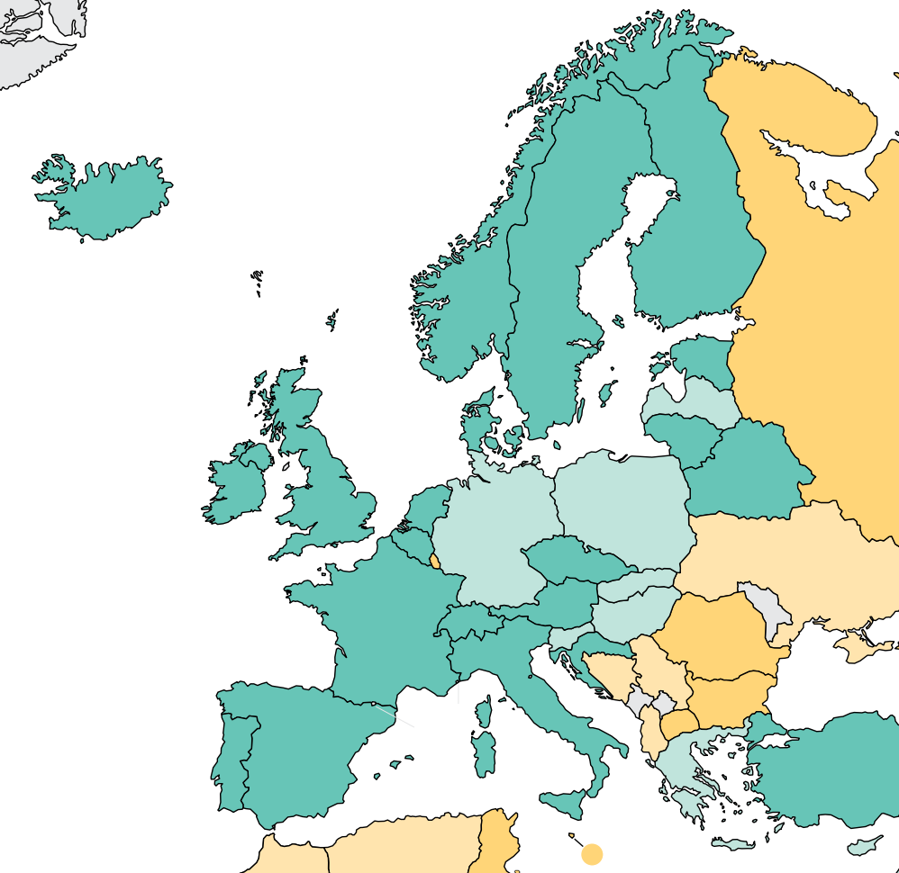
Burden of kidney failure (cont’d)
Country | Kidney transplantation
 | Incidence overall | Prevalence overall | Incidence of deceased donor | Incidence of living donor | Incidence of pre-emptive
Andorra | - | - | - | - | -
Austria | 34 | 507.1 | 29.33 | 4.67 | 6.7
Belgium | 35.95 | 569.65 | 30.86 | 5.09 | 2.9
Denmark | 43.45 | 517.7 | 31.72 | 11.72 | 10
Finland | 48.73 | 601 | 40.36 | 8.36 | 4.3
France | 49.72 | 622.3 | 42.05 | 7.68 | 7.1
Germany | 23.74 | - | 18.08 | 5.66 | -
Greece | 16.54 | 248.9 | 7.98 | 8.56 | 1.1
Iceland | 30 | 565.8 | 23.33 | 6.67 | 13.9
Ireland | 27.8 | 533 | 20.8 | 7 | -
Israel | 54.09 | 492 | 16.93 | 37.16 | -
Italy | 31.52 | 476 | 26.83 | 4.69 | -
Liechtenstein | - | - | - | - | -
Luxembourg | 12 | - | 12 | 0 | -
Malta | 7.5 | - | 7.5 | 0 | -
Netherlands | 53.26 | 695.2 | 26.98 | 26.28 | 16.8
Norway | 44.7 | 686.4 | 33.52 | 10.93 | 11.8
Portugal | 42.06 | 707 | 38.53 | 3.53 | -
Spain | 63.17 | 751.2 | 56.25 | 6.92 | 6.8
Sweden | 43.63 | 594.7 | 32.06 | 11.57 | 9.7
Switzerland | 41.61 | 519.2 | 27.59 | 14.02 | 5.1
United Kingdom | 42.77 | 735 | 32.02 | 10.75 | 12.8
Incidence of kidney transplantation
* pmp (per million population)
Data source: ERA-EDTA Registry Annual Report 2019, Finnish Registry for Kidney Diseases Report 2020, GODT database (http://www.transplant-observatory.org/data-charts-and-tables/), The Norwegian Renal Registry Annual Report 2020, UK Renal Registry 23rd Annual Report, 2019 USRDS Annual Data Report
‘ – ’ : data not reported/unavailable

Slide 16
Annual cost of kidney replacement therapy components
Country | Hemodialysis | Peritoneal dialysis | Kidney Transplant (First year) | Kidney Transplant (later years) | HD/PD ratio
Austria | - | - | - | - | -
Belgium | 60853 | 29147 | 76552 | 22635 | 2.09
Denmark | 71318 | 63935 | 35737 | 9920 | 1.12
Finland | 65842 | 31057 | 27394 | 578 | 2.12
France | 67830 | 37269 | 71627 | 14480 | 1.82
Germany | 48256 | 35465 | 126993 | 29533 | 1.36
Greece | 79499 | 32622 | 76629 | 19924 | 2.44
Iceland | 24419 | 27206 | - | - | 0.90
Ireland | 81031 | 18959 | - | - | 4.27
Israel | 66861 | 40809 | - | - | 1.64
Italy | 62082 | 72627 | - | - | 0.85
Liechtenstein | 32029 | 21076 | 96430 | 14091 | 1.52
Luxembourg | - | - | - | - | -
Malta | - | - | - | - | -
Netherlands | - | - | - | - | -
Norway | 99419 | 66655 | 118595 | 41254 | 1.49
Portugal | 71791 | 50534 | 41108 | 25242 | 1.42
Spain | 30361 | 30361 | 116952 | 12379 | 1.00
Sweden | 26937 | 59854 | 64822 | 10630 | 0.45
Switzerland | 80520 | - | 94144 | 18054 | -
United Kingdom | 94085 | 83070 | 19255 | - | 1.13
*Cost is in $US 2021
Abbreviations: HD (hemodialysis), PD (peritoneal dialysis)
Data source: Cavallo et al. (2014), Ferguson et al. (2022), Hackl et al. (2021), Haller et al. (2011), Helantera et al. (2019), Jakobsen et al. (1990), Jarl et al. (2018), Jensen et al. (2014), Jurgensen et al. (2015), Kerr et al. (2012), Li et al. (2015), Mohnen et al. (2019), Roberts et al. (2022), Rocha et al. (2011), Sandoz et al. (2004), Van Biesen et al. (2007), van der Tol et al. (2019), Villa et al. (2011), Zambrowski (2016)
‘ – ’ : data not reported/unavailable

Slide 17
Country level scorecard
Country |  | Availability of KRT |  |  | Availability of CKM |  |  | Funding for Medications |  |  | Availability of Distribution of Registry |  |  |  | Advocacy Group |  |  | Nephrology Workforce (PMP)
 |  | HD | PD | Kidney transplantation | Shared decision | Choice restricted (limited) | Choice restricted (not limited) | CKD | Dialysis | Kidney transplantation | CKD | Dialysis | Kidney transplantation | AKI | CKD | AKI | RRT | Nephrologist | Nephrologist trainees
Andorra | 2019
 | 2023 |  |  |  |  |  |  |  |  |  |  |  |  |  |  |  |  | 0.00 | 0.00
Austria | 2019 |  |  |  |  |  |  |  |  |  |  |  |  |  |  |  |  | 34.12 | 5.69
 | 2023 |  |  |  |  |  |  |  |  |  |  |  |  |  |  |  |  | 33.66 | 5.61
Belgium | 2019
 | 2023 |  |  |  |  |  |  |  |  |  |  |  |  |  |  |  |  | 21.10 | 4.22
Denmark | 2019 |  |  |  |  |  |  |  |  |  |  |  |  |  |  |  |  | 25.82 | 4.48
 | 2023 |  |  |  |  |  |  |  |  |  |  |  |  |  |  |  |  | 25.33 | 4.05
Finland | 2019 |  |  |  |  |  |  |  |  |  |  |  |  |  |  |  |  | 14.45 | 1.81
 | 2023 |  |  |  |  |  |  |  |  |  |  |  |  |  |  |  |  | 19.64 | 8.93
France | 2019 |  |  |  |  |  |  |  |  |  |  |  |  |  |  |  |  | 20.04 | 5.05
 | 2023 |  |  |  |  |  |  |  |  |  |  |  |  |  |  |  |  | 17.57 | 5.86
Germany | 2019 |  |  |  |  |  |  |  |  |  |  |  |  |  |  |  |  | 18.64 | 3.73
 | 2023 |  |  |  |  |  |  |  |  |  |  |  |  |  |  |  |  | 27.01 | 0.59
Greece | 2019 |  |  |  |  |  |  |  |  |  |  |  |  |  |  |  |  | 55.75 | 7.43
 | 2023 |  |  |  |  |  |  |  |  |  |  |  |  |  |  |  |  | 36.07 | 9.49
Iceland | 2019 |  |  |  |  |  |  |  |  |  |  |  |  |  |  |  |  | 29.11
 | 2023 |  |  |  |  |  |  |  |  |  |  |  |  |  |  |  |  | 30.76 | 0.00
Ireland | 2019 |  |  |  |  |  |  |  |  |  |  |  |  |  |  |  |  | 9.47 | 5.92
 | 2023 |  |  |  |  |  |  |  |  |  |  |  |  |  |  |  |  | 11.75 | 9.48
Israel | 2019 |  |  |  |  |  |  |  |  |  |  |  |  |  |  |  |  | 29.67 | 2.37
 | 2023 |  |  |  |  |  |  |  |  |  |  |  |  |  |  |  |  | 24.68 | 3.93
Abbreviations
KRT: kidney replacement therapy
CKM: conservative kidney management
CKD: chronic kidney disease
AKI: acute kidney injury
RRT: renal replacement therapy
Yes | No | N/A

Slide 18
Country level scorecard
Country |  | Availability of KRT |  |  | Availability of CKM |  |  | Funding for Medications |  |  | Availability of Distribution of Registry |  |  |  | Advocacy Group |  |  | Nephrology Workforce (PMP)
 |  | HD | PD | Kidney transplantation | Shared decision | Choice restricted (limited) | Choice restricted (not limited) | CKD | Dialysis | Kidney transplantation | CKD | Dialysis | Kidney transplantation | AKI | CKD | AKI | RRT | Nephrologist | Nephrologist trainees
Italy | 2019 |  |  |  |  |  |  |  |  |  |  |  |  |  |  |  |  | 48.20 | 8.03
 | 2023 |  |  |  |  |  |  |  |  |  |  |  |  |  |  |  |  |  | 49.10
Liechtenstein | 2019 |  |  |  |  |  |  |  |  |  |  |  |  |  |  |  |  | 51.88 | 0.00
 | 2023 |  |  |  |  |  |  |  |  |  |  |  |  |  |  |  |  | 100.73 | 0.00
Luxembourg | 2019 |  |  |  |  |  |  |  |  |  |  |  |  |  |  |  |  | 21.46
 | 2023 |  |  |  |  |  |  |  |  |  |  |  |  |  |  |  |  | 12.30 | 6.15
Malta | 2019 |  |  |  |  |  |  |  |  |  |  |  |  |  |  |  |  | 13.36 | 22.27
 | 2023 |  |  |  |  |  |  |  |  |  |  |  |  |  |  |  |  |  | 17.23
Netherlands | 2019 |  |  |  |  |  |  |  |  |  |  |  |  |  |  |  |  | 17.49 | 2.33
 | 2023 |  |  |  |  |  |  |  |  |  |  |  |  |  |  |  |  | 15.17 | 2.30
Norway | 2019 |  |  |  |  |  |  |  |  |  |  |  |  |  |  |  |  | 27.92 | 18.61
 | 2023 |  |  |  |  |  |  |  |  |  |  |  |  |  |  |  |  | 27.37 | 9.00
Portugal | 2019 |  |  |  |  |  |  |  |  |  |  |  |  |  |  |  |  | 27.52 | 9.66
 | 2023 |  |  |  |  |  |  |  |  |  |  |  |  |  |  |  |  | 34.17 | 14.65
Spain | 2019 |  |  |  |  |  |  |  |  |  |  |  |  |  |  |  |  | 20.27 | 7.30
 | 2023 |  |  |  |  |  |  |  |  |  |  |  |  |  |  |  |  | 53.01 | 10.60
Sweden | 2019 |  |  |  |  |  |  |  |  |  |  |  |  |  |  |  |  | 22.91 | 8.96
 | 2023 |  |  |  |  |  |  |  |  |  |  |  |  |  |  |  |  | 23.85 | 6.68
Switzerland | 2019 |  |  |  |  |  |  |  |  |  |  |  |  |  |  |  |  | 30.15 | 5.12
 | 2023 |  |  |  |  |  |  |  |  |  |  |  |  |  |  |  |  | 41.13 | 5.88
United Kingdom | 2019 |  |  |  |  |  |  |  |  |  |  |  |  |  |  |  |  | 9.78 | 6.14
 | 2023 |  |  |  |  |  |  |  |  |  |  |  |  |  |  |  |  | 12.13 | 6.15
Abbreviations
KRT: kidney replacement therapy
CKM: conservative kidney management
CKD: chronic kidney disease
AKI: acute kidney injury
RRT: renal replacement therapy
Yes | No | N/A

Slide 19
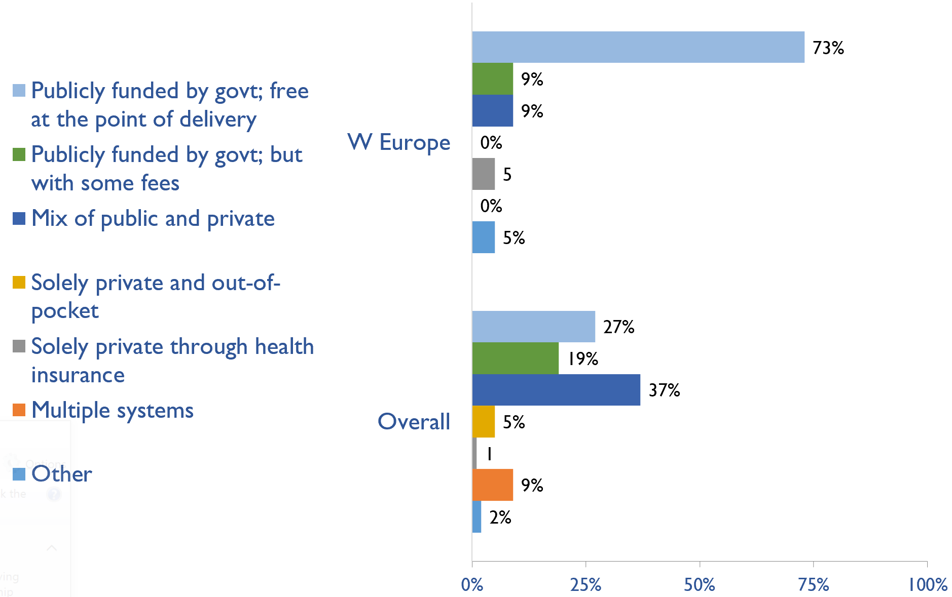
Funding for non-dialysis CKD
Country | Publicly funded by govt; free at the point of delivery | Publicly funded by govt but with some fees at the point of delivery | Mix of public and private funding systems | Solely private and out-of-pocket | Solely private through health insurance | Multiple systems | Other
Andorra |  |  |  |  |  |  | X
Austria | X
Belgium | X
Denmark | X
Finland |  | X
France | X
Germany | X
Greece | X
Iceland |  |  | X
Ireland |  |  | X
Israel | X
Italy | X
Liechtenstein |  |  |  | X
Luxembourg | X
Malta | X
Netherlands | X
Norway | X
Portugal | X
Spain | X
Sweden |  | X
Switzerland | X
United Kingdom | X
X : Yes

Slide 20
Funding for kidney replacement therapy (KRT)
Country | Publicly funded (free) |  |  |  | Publicly funded (some fees) |  |  |  | Mixed |  |  |  | Solely private (out-of-pocket) |  |  |  | Solely private (health insurance) |  |  |  | Multiple systems |  |  |  | N/A |  |  |  | Other
 | AKI | HD | PD | TX | AKI | HD | PD | TX | AKI | HD | PD | TX | AKI | HD | PD | TX | AKI | HD | PD | TX | AKI | HD | PD | TX | AKI | HD | PD | TX | AKI | HD | PD | TX
Andorra |  |  |  |  |  |  |  |  |  |  |  |  |  |  |  |  |  |  |  |  | X | X | X |  |  |  |  | X
Austria | X | X | X | X
Belgium | X | X | X | X
Denmark | X | X | X | X
Finland | X | X | X | X
France | X | X | X | X
Germany | X | X | X | X
Greece | X | X | X | X
Iceland | X | X | X | X
Ireland | X | X | X |  |  |  |  | X
Israel | X | X | X | X
Italy | X | X | X | X
Liechtenstein |  |  |  |  |  |  |  |  |  |  |  |  |  |  |  |  | X | X | X | X
Luxembourg | X | X | X | X
Malta | X | X | X | X
Netherlands | X | X | X | X
Norway | X | X | X | X
Portugal | X | X | X | X
Spain | X | X | X | X
Sweden | X |  | X | X |  |  |  |  |  | X
Switzerland | X | X | X | X
United Kingdom | X | X | X | X
X : Yes
Abbreviations: AKI (Acute kidney injury), HD (hemodialysis), PD (peritoneal dialysis), TX (transplant medications)

Slide 21
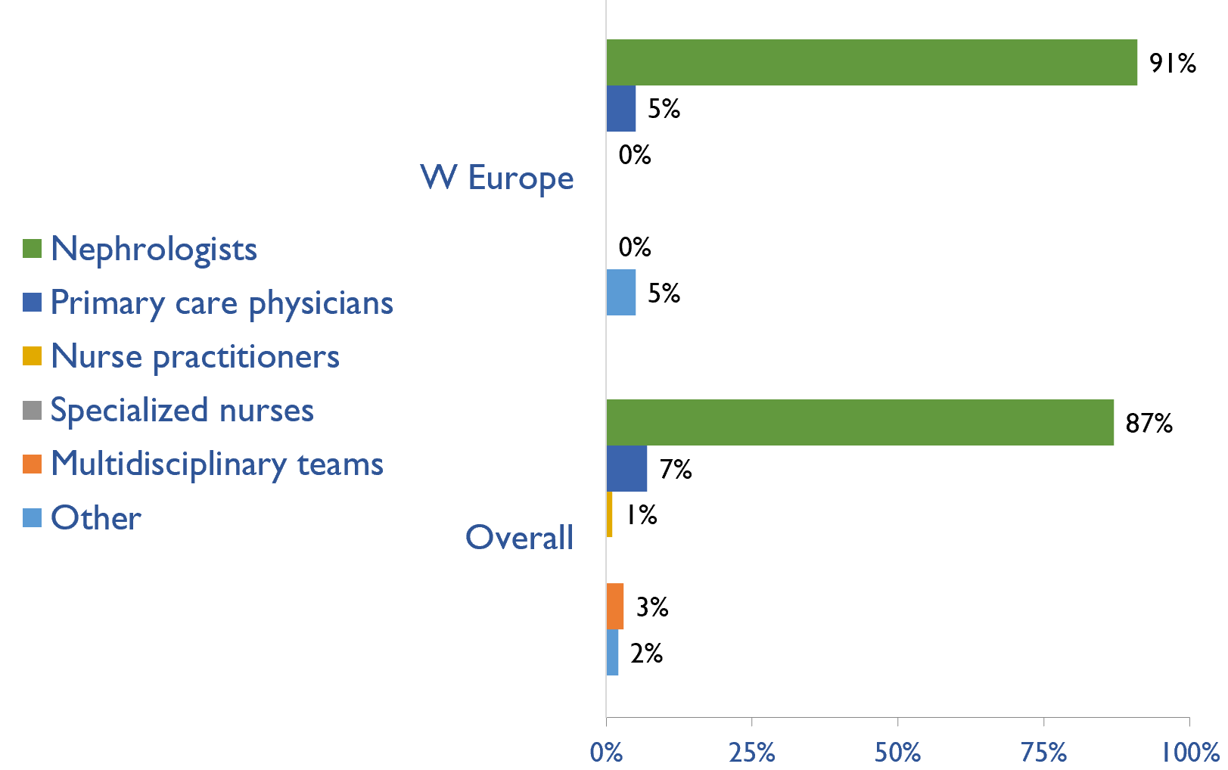
Providers primarily responsible for kidney failure care
Country | Nephrologists | Primary care physicians | Nurse practitioners | Specialized nurses | Multidisciplinary teams | Other
Andorra |  | X
Austria | X
Belgium | X
Denmark | X
Finland | X
France | X
Germany | X
Greece | X
Iceland | X
Ireland | X
Israel | X
Italy | X
Liechtenstein | X
Luxembourg |  |  |  |  |  | X
Malta | X
Netherlands | X
Norway | X
Portugal | X
Spain | X
Sweden | X
Switzerland | X
United Kingdom | X
X : Yes

Slide 22
Shortage of kidney failure care providers
Country | Nephrologists | Pediatric nephrologists | Transplant surgeons | Surgeons (HD access) | Surgeons (PD access) | Dietitians | Laboratory technicians | Radiologists (ultrasound) | Vascular access coordinators
Andorra
Austria
Belgium
Denmark
Finland
France
Germany
Greece
Iceland
Ireland
Israel
Italy
Liechtenstein
Luxembourg
Malta
Netherlands
Norway
Portugal
Spain
Sweden
Switzerland
United Kingdom
No shortage
Shortage

Slide 23
Shortage of kidney failure care providers
Country | Counsellors/ psychologists | Transplant coordinators | Dialysis nurses | Renal nurses | Dialysis technicians | Social workers | Palliative care physicians | Kidney supportive care nurses | No shortage
Andorra
Austria
Belgium
Denmark
Finland
France
Germany
Greece
Iceland
Ireland
Israel
Italy
Liechtenstein
Luxembourg
Malta
Netherlands
Norway
Portugal
Spain
Sweden
Switzerland
United Kingdom
No shortage
Shortage

Slide 24
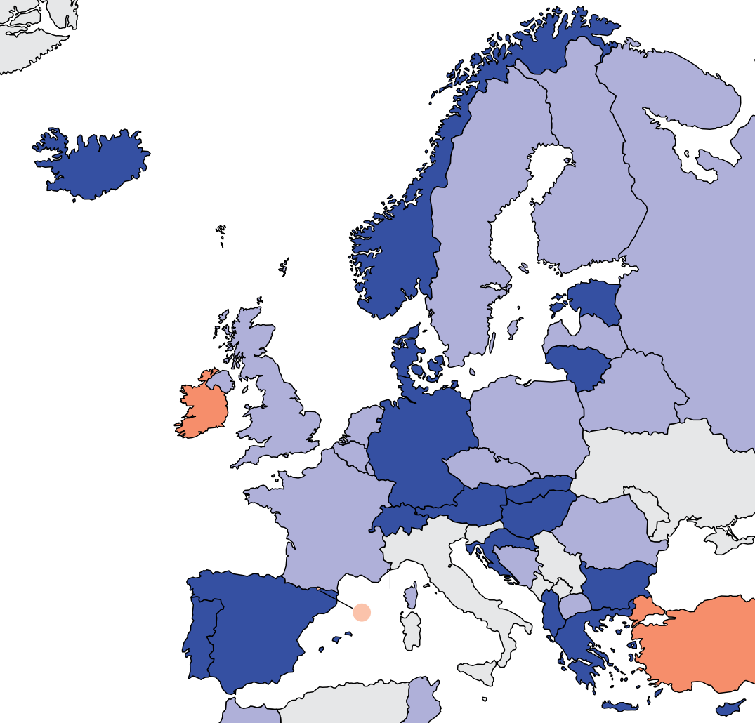
Prevalence of nephrologists and trainees
Nephrologists
Country | Nephrologists PMP | Nephrology trainees PMP
Andorra | 0.00 | 0.00
Austria | 33.66 | 5.61
Belgium | 21.10 | 4.22
Denmark | 25.33 | 4.05
Finland | 19.64 | 8.93
France | 17.57 | 5.86
Germany | 27.01 | 0.59
Greece | 36.07 | 9.49
Iceland | 30.76 | 0.00
Ireland | 11.75 | 9.48
Israel | 24.68 | 3.93
Italy | - | 49.10
Liechtenstein | 100.73 | 0.00
Luxembourg | 12.30 | 6.15
Malta | - | 17.23
Netherlands | 15.17 | 2.30
Norway | 27.37 | 9.00
Portugal | 34.17 | 14.65
Spain | 53.01 | 10.60
Sweden | 23.85 | 6.68
Switzerland | 41.13 | 5.88
United Kingdom | 12.13 | 6.15
‘ – ’ : data not reported/unavailable

Slide 25
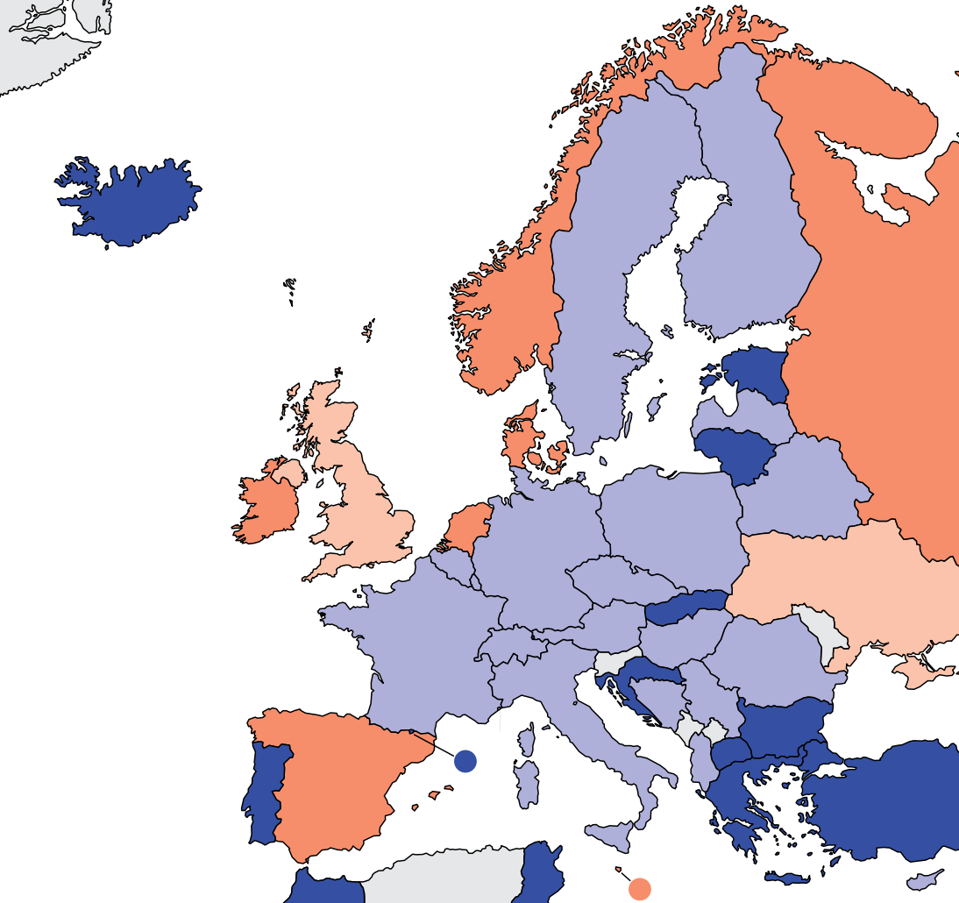
Capacity for chronic dialysis (HD)
Chronic HD centers
Country | Chronic HD Centres PMP
Andorra | 11.69
Austria | 5.61
Belgium | 8.44
Denmark | 2.70
Finland | 5.18
France | 9.31
Germany | 8.66
Greece | 18.99
Iceland | 13.98
Ireland | 2.46
Israel | 7.74
Italy | 9.00
Liechtenstein | 25.18
Luxembourg | 7.69
Malta | 4.31
Netherlands | 3.62
Norway | 4.50
Portugal | 12.89
Spain | 4.24
Sweden | 6.68
Switzerland | 10.58
United Kingdom | 1.00
Chronic HD services are available in all countries of the region
The Western Europe average of HD treatment centers is 8.38 pmp

Slide 26
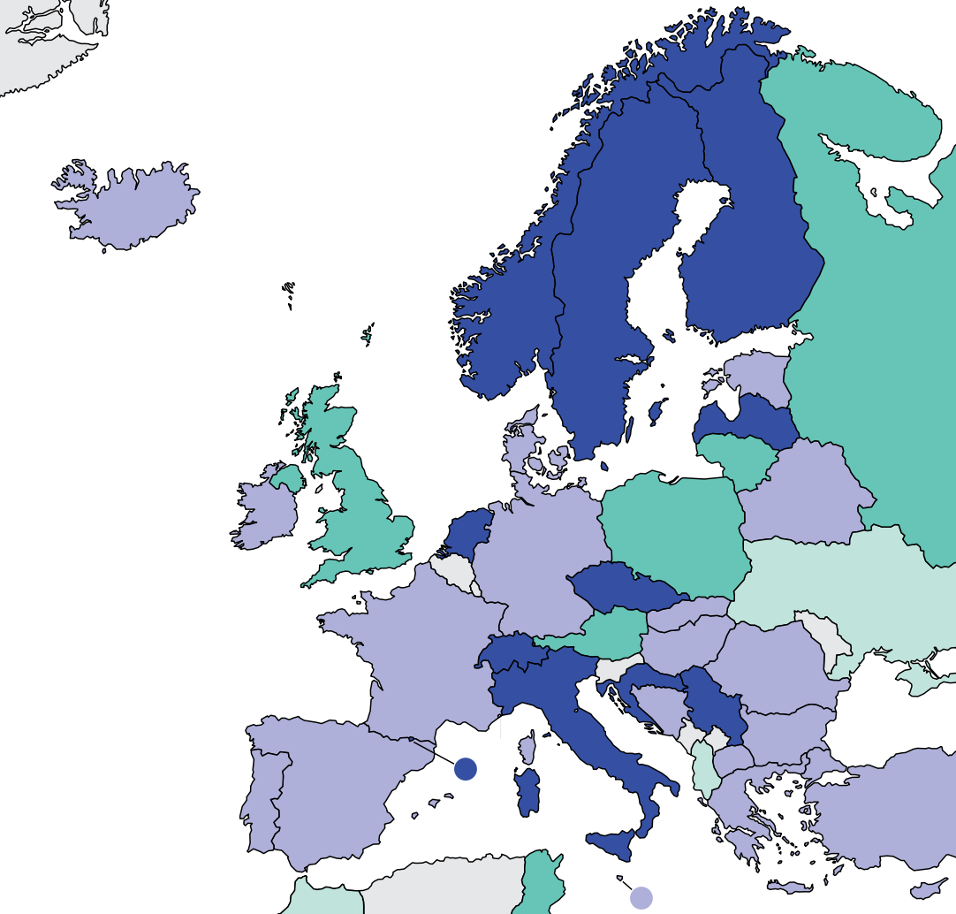
Capacity for chronic dialysis (PD)
Chronic PD centers
Country | Chronic PD Centres PMP
Andorra | 11.69
Austria | 1.12
Belgium | -
Denmark | 2.70
Finland | 3.93
France | 2.20
Germany | 2.73
Greece | 2.85
Iceland | 2.80
Ireland | 1.90
Israel | 2.24
Italy | 3.27
Liechtenstein | 25.18
Luxembourg | 1.54
Malta | 2.15
Netherlands | 3.74
Norway | 4.68
Portugal | 1.95
Spain | 1.70
Sweden | 5.25
Switzerland | 7.05
United Kingdom | 1.00
Chronic PD services are available in all countries of the region
The Western Europe average of PD treatment centers is 4.36 pmp

Slide 27
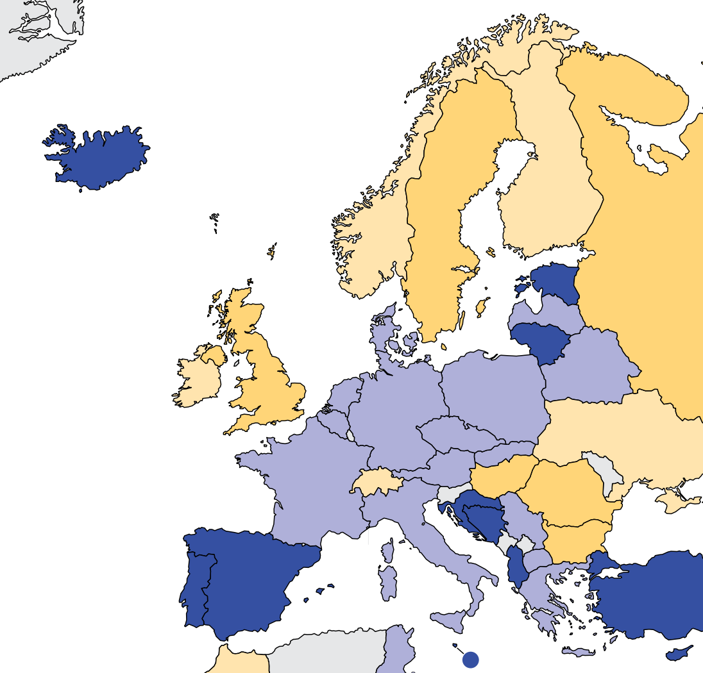
Capacity for Kidney Transplantation
Kidney transplantation centers
Country | Kidney Transplantation availability | Transplant centers PMP
Andorra
Austria | X | 0.45
Belgium | X | 0.59
Denmark | X | 0.51
Finland | X | 0.18
France | X | 0.69
Germany | X | 0.55
Greece | X | 0.57
Iceland | X | 2.80
Ireland | X | 0.19
Israel | X | 0.67
Italy | X | 0.65
Liechtenstein
Luxembourg
Malta | X | 2.15
Netherlands | X | 0.46
Norway | X | 0.18
Portugal | X | 0.78
Spain | X | 0.85
Sweden | X | 0.38
Switzerland | X | 0.12
United Kingdom | X | 0.34
Kidney transplantation services are available in 19 (86%) countries of the region
The Western Europe average of Kidney transplantation centers is 0.69 pmp
X : Yes
‘ – ’ : data not reported/unavailable

Slide 28
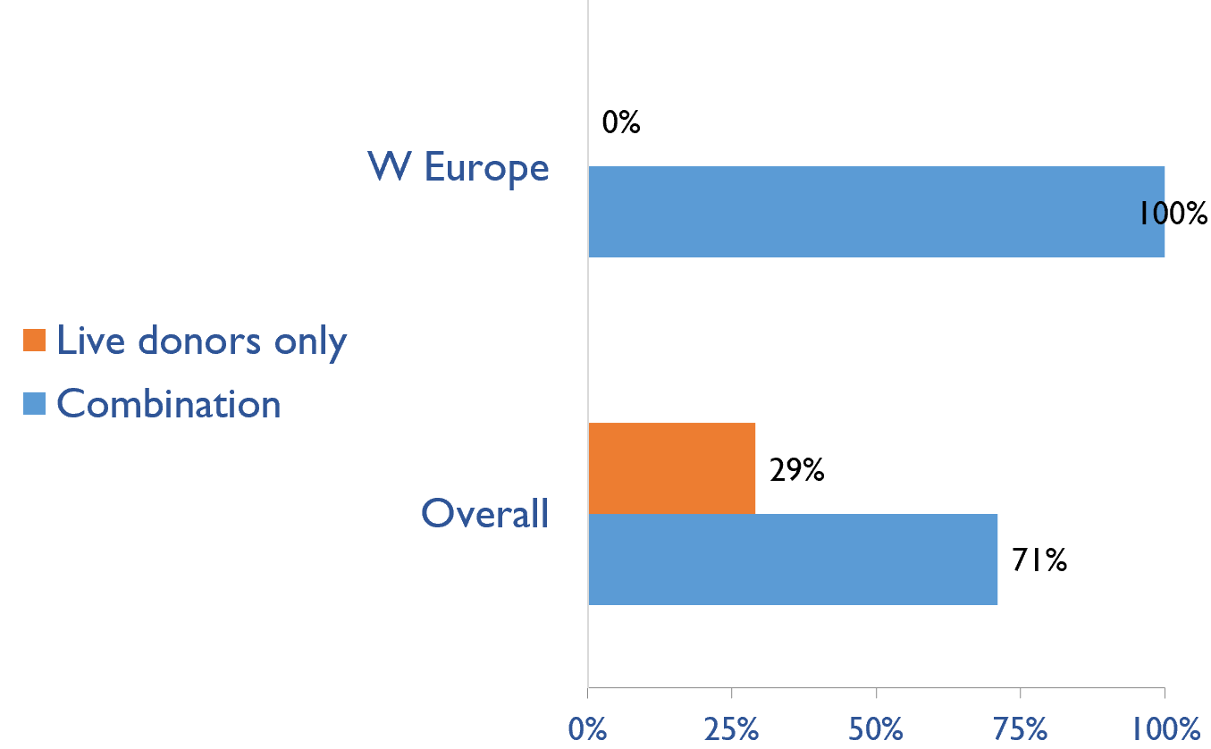
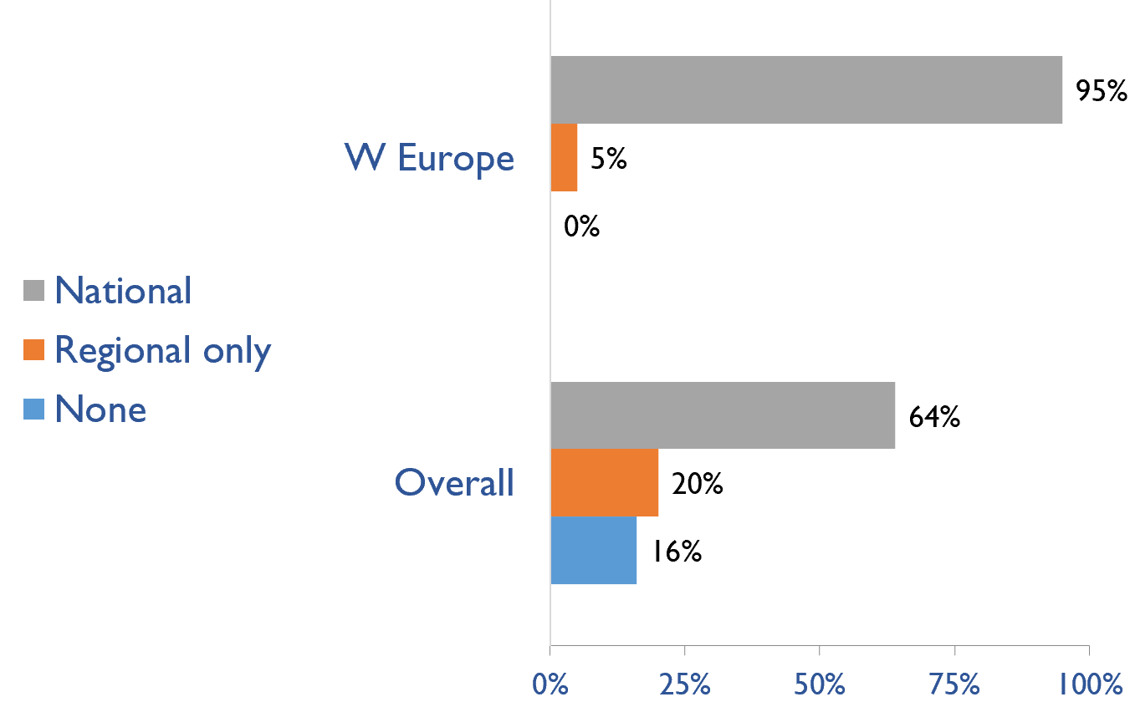
Capacity for Kidney Transplantation (cont’d)
Country | Donor type |  | Transplant waitlist
 | Live donors only | Combination | National | Regional only | None
Andorra
Austria |  | X | X
Belgium |  | X | X
Denmark |  | X | X
Finland |  | X | X
France |  | X | X
Germany |  | X | X
Greece |  | X | X
Iceland |  | X | X
Ireland |  | X | X
Israel |  | X | X
Italy |  | X | X
Liechtenstein
Luxembourg
Malta |  | X | X
Netherlands |  | X | X
Norway |  | X | X
Portugal |  | X | X
Spain |  | X |  | X
Sweden |  | X | X
Switzerland |  | X | X
United Kingdom |  | X | X
Transplant donor type
Transplant waitlist
X : Yes

Slide 29
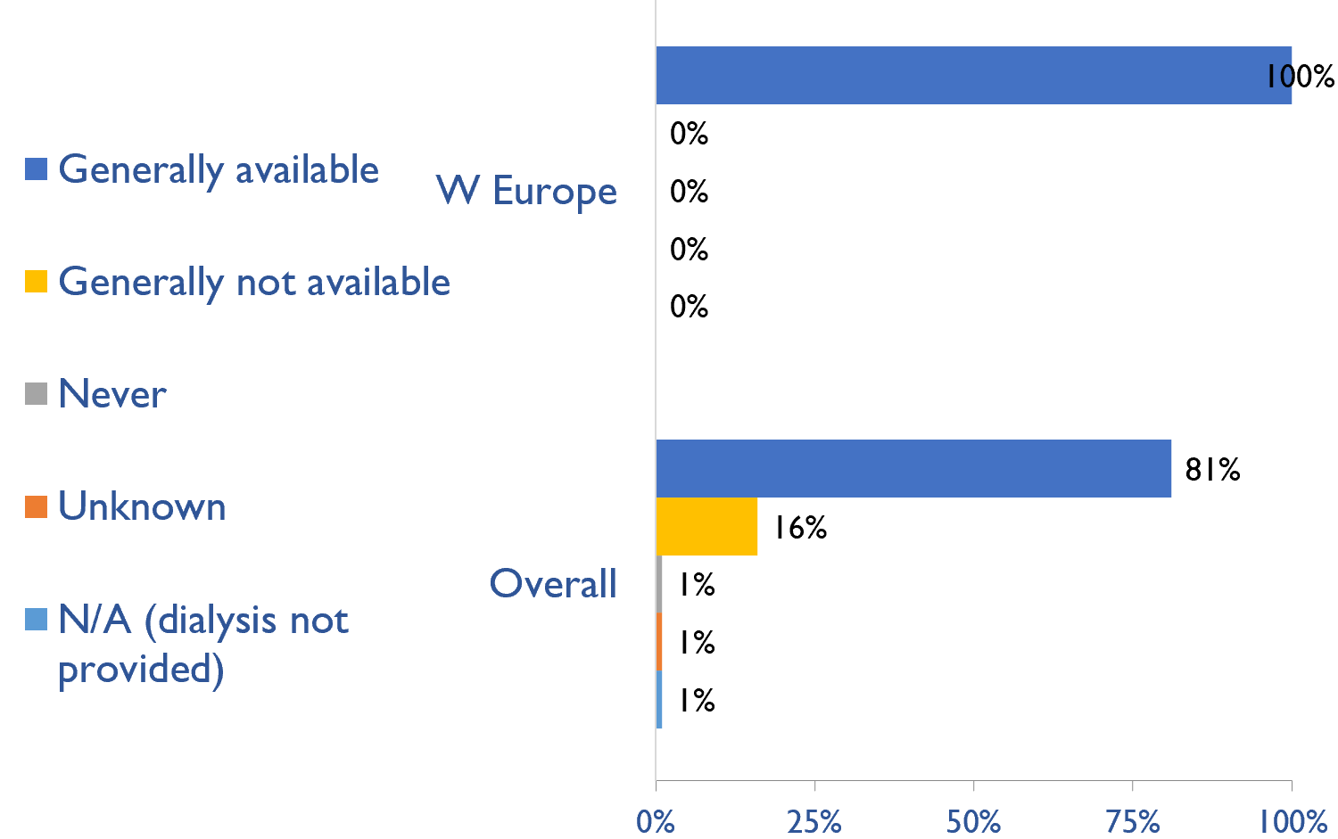
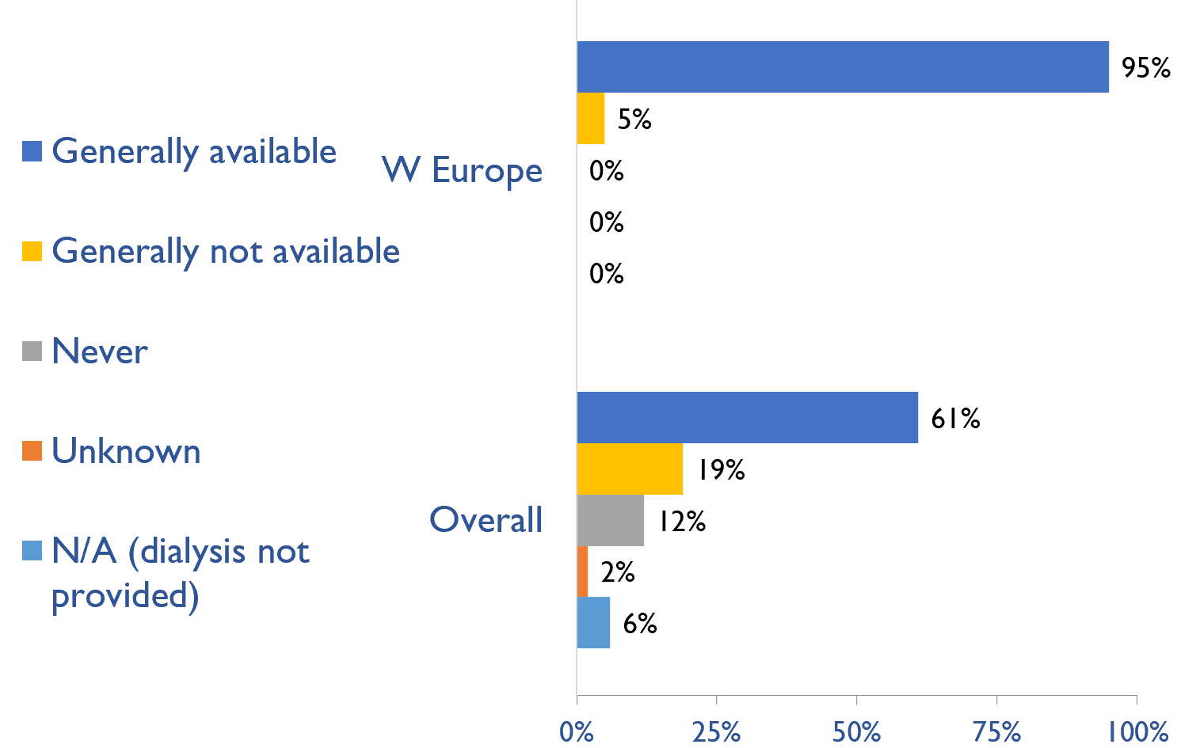
Availability of services within dialysis care
HD frequency
Country | HD frequency a center-based service that involves treatment 3x week/3-4x hours |  |  |  |  | PD frequency ability to do adequate exchanges 3-4x day (or equivalent cycles on automated PD)
 | Generally available | Generally not available | Never | Unknown | N/A (dialysis not provided) | Generally available | Generally not available | Never | Unknown | N/A (dialysis not provided)
Andorra | X |  |  |  |  | X
Austria | X |  |  |  |  | X
Belgium | X |  |  |  |  | X
Denmark | X |  |  |  |  | X
Finland | X |  |  |  |  | X
France | X |  |  |  |  | X
Germany | X |  |  |  |  | X
Greece | X |  |  |  |  | X
Iceland | X |  |  |  |  | X
Ireland | X |  |  |  |  | X
Israel | X |  |  |  |  | X
Italy | X |  |  |  |  | X
Liechtenstein | X |  |  |  |  | X
Luxembourg | X |  |  |  |  |  | X
Malta | X |  |  |  |  | X
Netherlands | X |  |  |  |  | X
Norway | X |  |  |  |  | X
Portugal | X |  |  |  |  | X
Spain | X |  |  |  |  | X
Sweden | X |  |  |  |  | X
Switzerland | X |  |  |  |  | X
United Kingdom | X |  |  |  |  | X
PD frequency
X : Yes

Slide 30
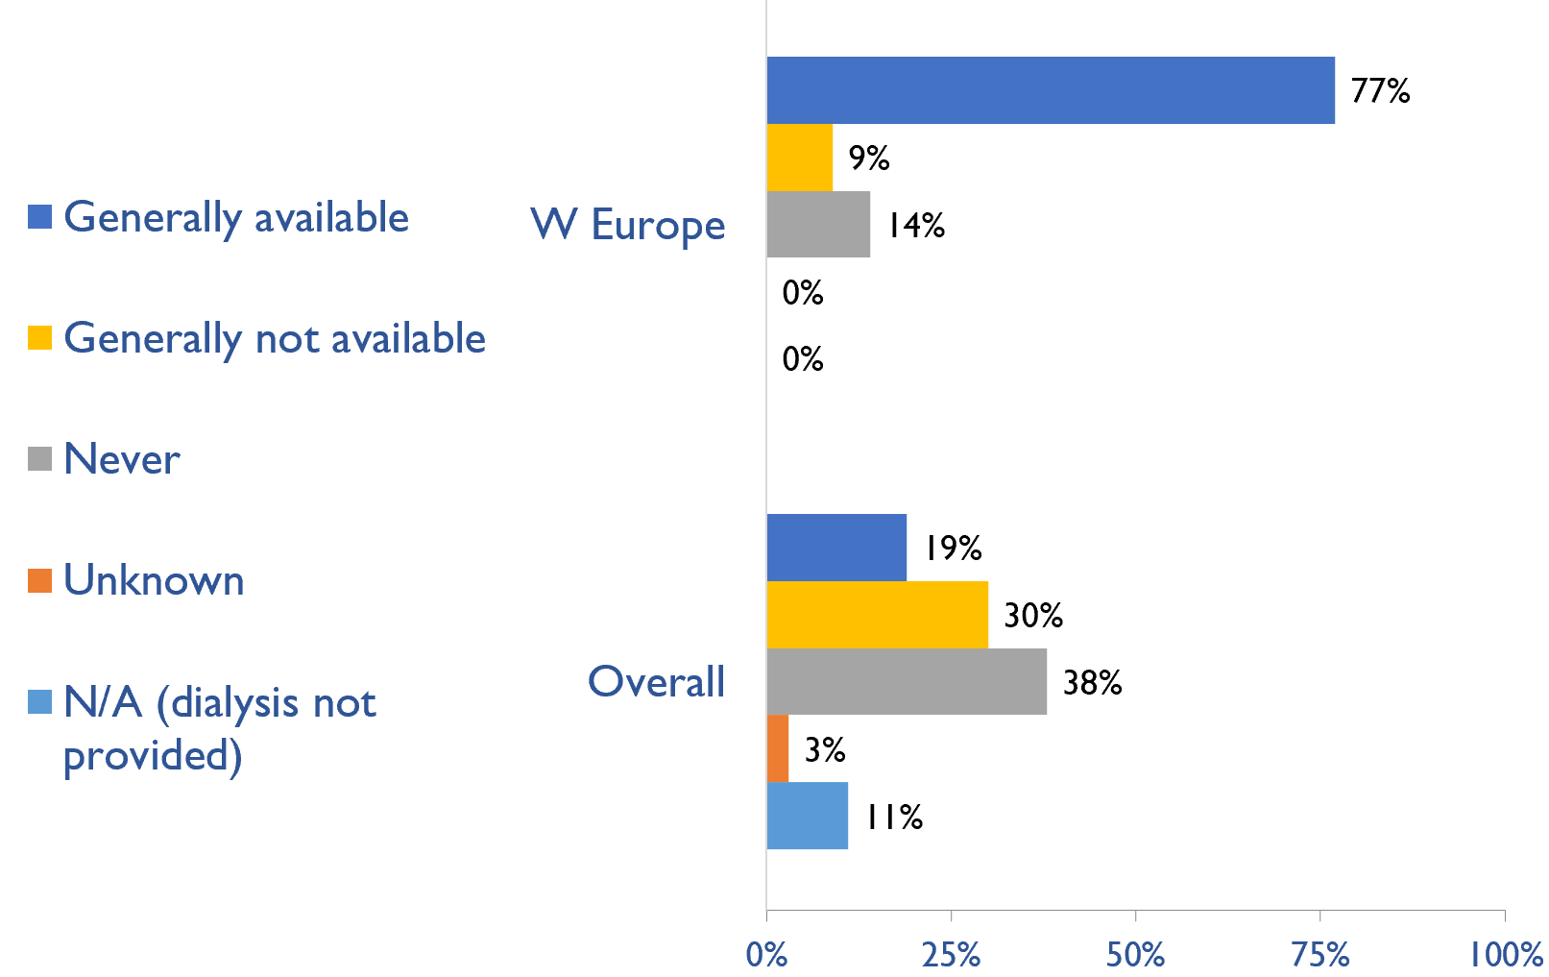
Availability of Home hemodialysis
Country | Availability of Home hemodialysis
 | Generally available | Generally not available | Never | Unknown | N/A (dialysis not provided)
Andorra | X
Austria | X
Belgium | X
Denmark | X
Finland | X
France | X
Germany | X
Greece |  |  | X
Iceland |  | X
Ireland | X
Israel |  | X
Italy | X
Liechtenstein | X
Luxembourg |  |  | X
Malta |  |  | X
Netherlands | X
Norway | X
Portugal | X
Spain | X
Sweden | X
Switzerland | X
United Kingdom | X
X : Yes

Slide 31
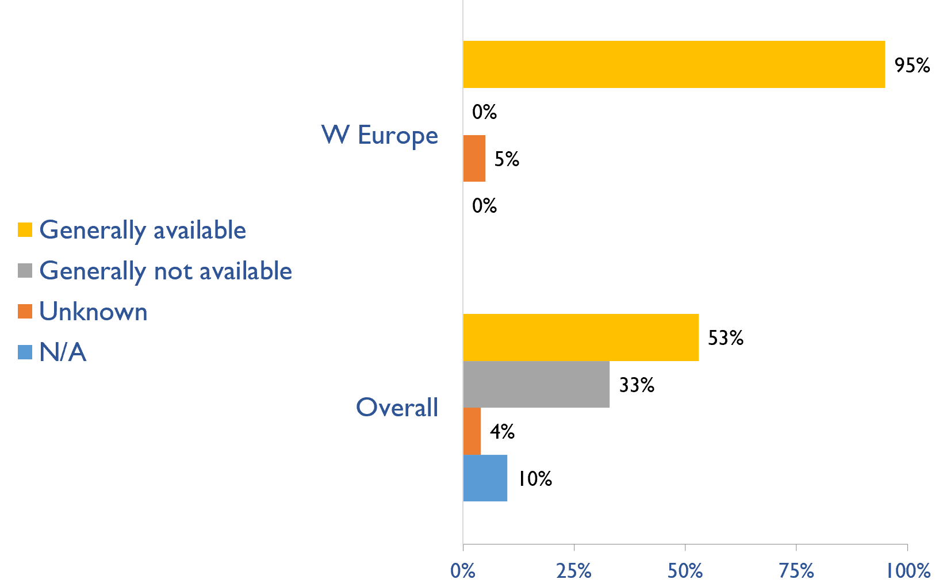
Capacity for conservative kidney management (CKM)
Country | Established conservative care that is chosen or medically advised
 | Generally available | Generally not available | Unknown | N/A (conservative care not available)
Andorra |  |  | X
Austria | X
Belgium | X
Denmark | X
Finland | X
France | X
Germany | X
Greece | X
Iceland | X
Ireland | X
Israel | X
Italy | X
Liechtenstein | X
Luxembourg | X
Malta | X
Netherlands | X
Norway | X
Portugal | X
Spain | X
Sweden | X
Switzerland | X
United Kingdom | X
X : Yes

Slide 32
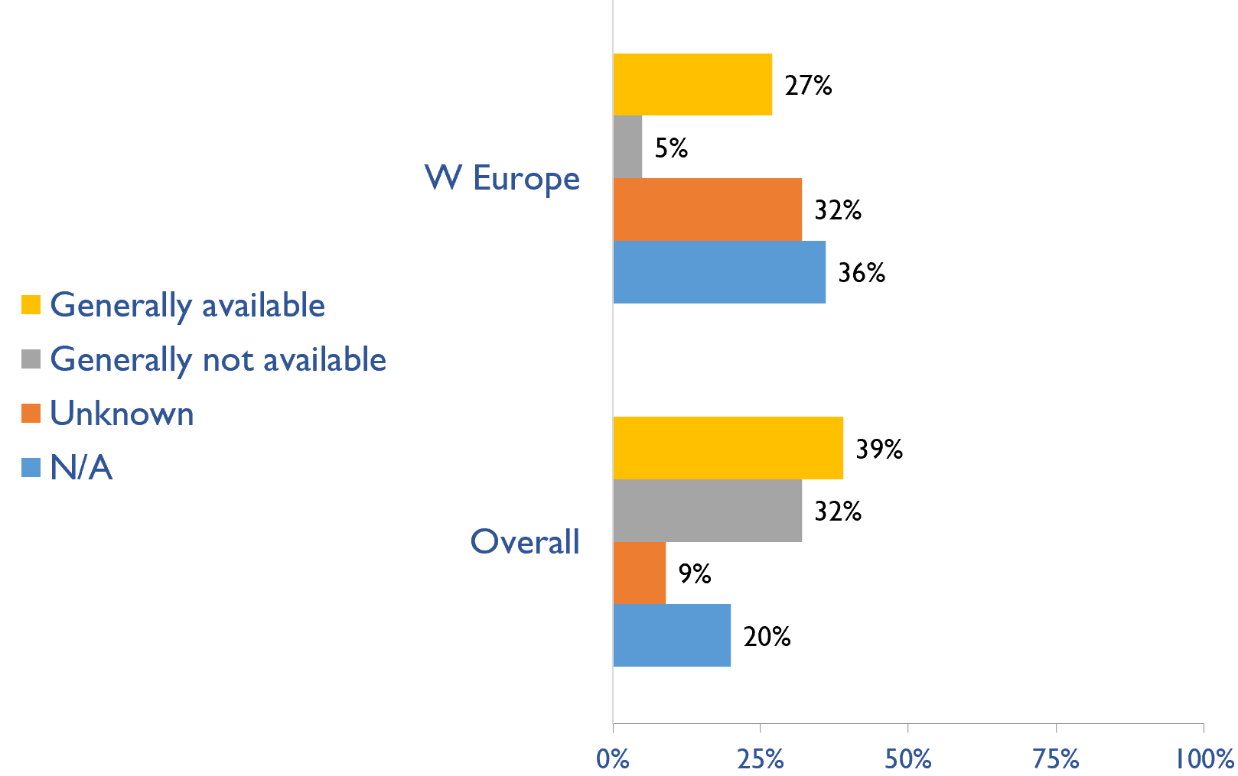
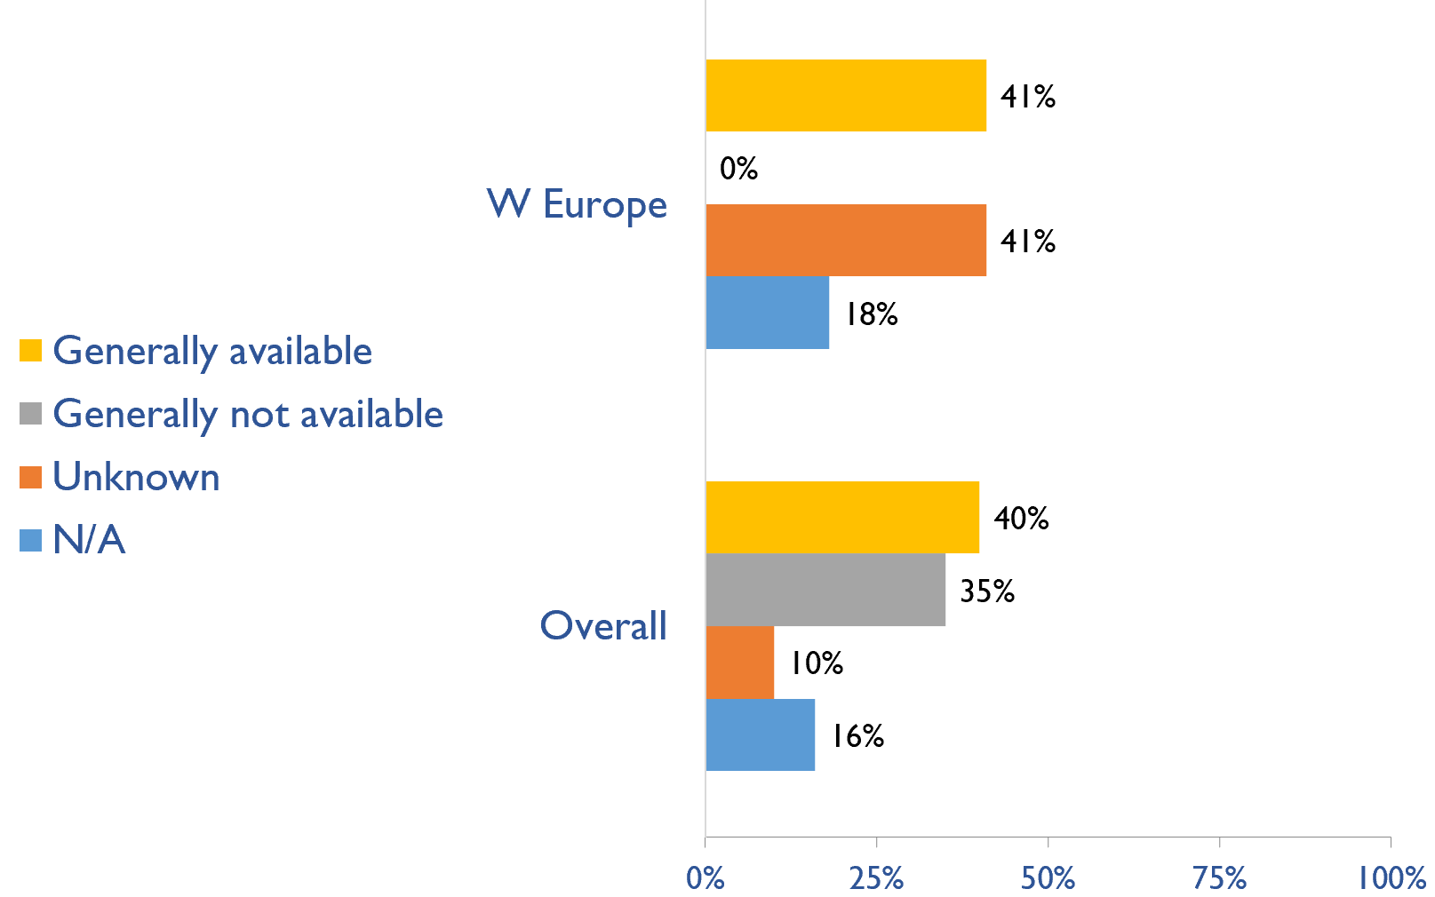
Capacity for conservative kidney management (CKM)
Where resource constraints to prevent or limit access to KRT
Country | where resource constraints to prevent or limit access to KRT |  |  |  | where there are no resource constraints to prevent or limit access to KRT
 | Generally available | Generally not available | Unknown | N/A (conservative care not available) | Generally available | Generally not available | Unknown | N/A (conservative care not available)
Andorra |  |  | X |  |  |  | X
Austria |  |  |  | X | X
Belgium |  |  |  | X |  |  | X
Denmark |  |  | X |  | X
Finland |  |  |  | X |  |  | X
France |  |  | X |  |  |  | X
Germany |  |  | X |  |  |  | X
Greece | X |  |  |  | X
Iceland | X |  |  |  | X
Ireland |  |  |  | X |  |  |  | X
Israel |  |  |  | X |  |  |  | X
Italy |  |  | X |  |  |  | X
Liechtenstein |  |  |  | X | X
Luxembourg | X |  |  |  | X
Malta | X |  |  |  | X
Netherlands |  |  |  | X |  |  |  | X
Norway |  |  | X |  |  |  | X
Portugal |  |  |  | X |  |  |  | X
Spain | X |  |  |  | X
Sweden | X |  |  |  | X
Switzerland |  | X |  |  |  |  | X
United Kingdom |  |  | X |  |  |  | X
Where there are no resource constraints to prevent or limit access to KRT
X : Yes

Slide 33
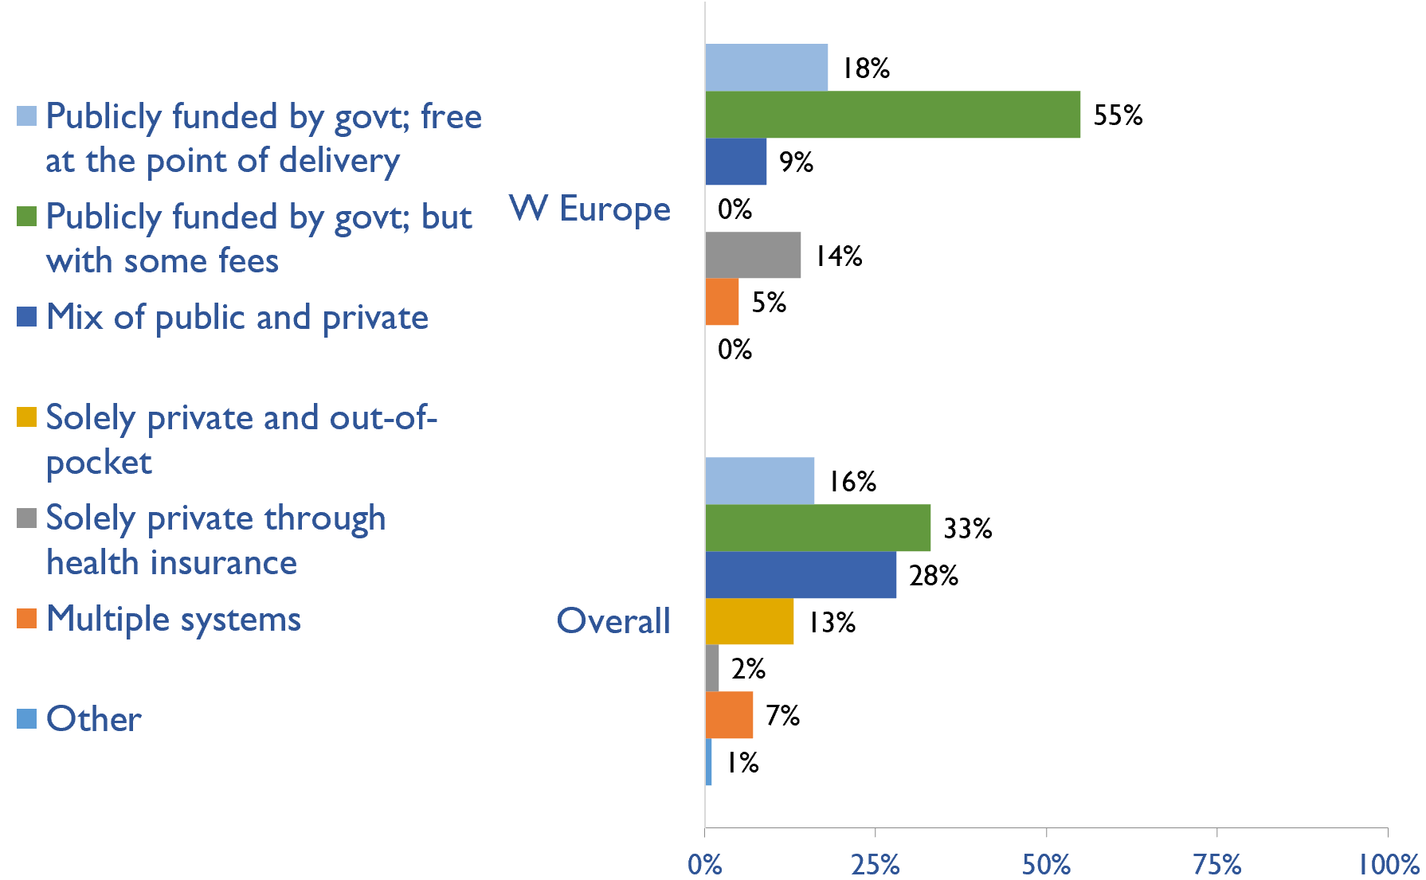
Funding for medications in CKD patients not on dialysis
Country | Publicly funded by govt; free at the point of delivery | Publicly funded by govt but with some fees at the point of delivery | Mix of public and private funding systems | Solely private and out-of-pocket | Solely private through health insurance providers | Multiple systems | Other
Andorra |  |  |  |  |  | X
Austria | X
Belgium |  | X
Denmark | X
Finland |  | X
France |  |  | X
Germany |  | X
Greece |  | X
Iceland |  | X
Ireland |  |  | X
Israel |  | X
Italy | X
Liechtenstein |  |  |  |  | X
Luxembourg |  | X
Malta | X
Netherlands |  |  |  |  | X
Norway |  | X
Portugal |  | X
Spain |  | X
Sweden |  | X
Switzerland |  |  |  |  | X
United Kingdom |  | X
X : Yes

Slide 34
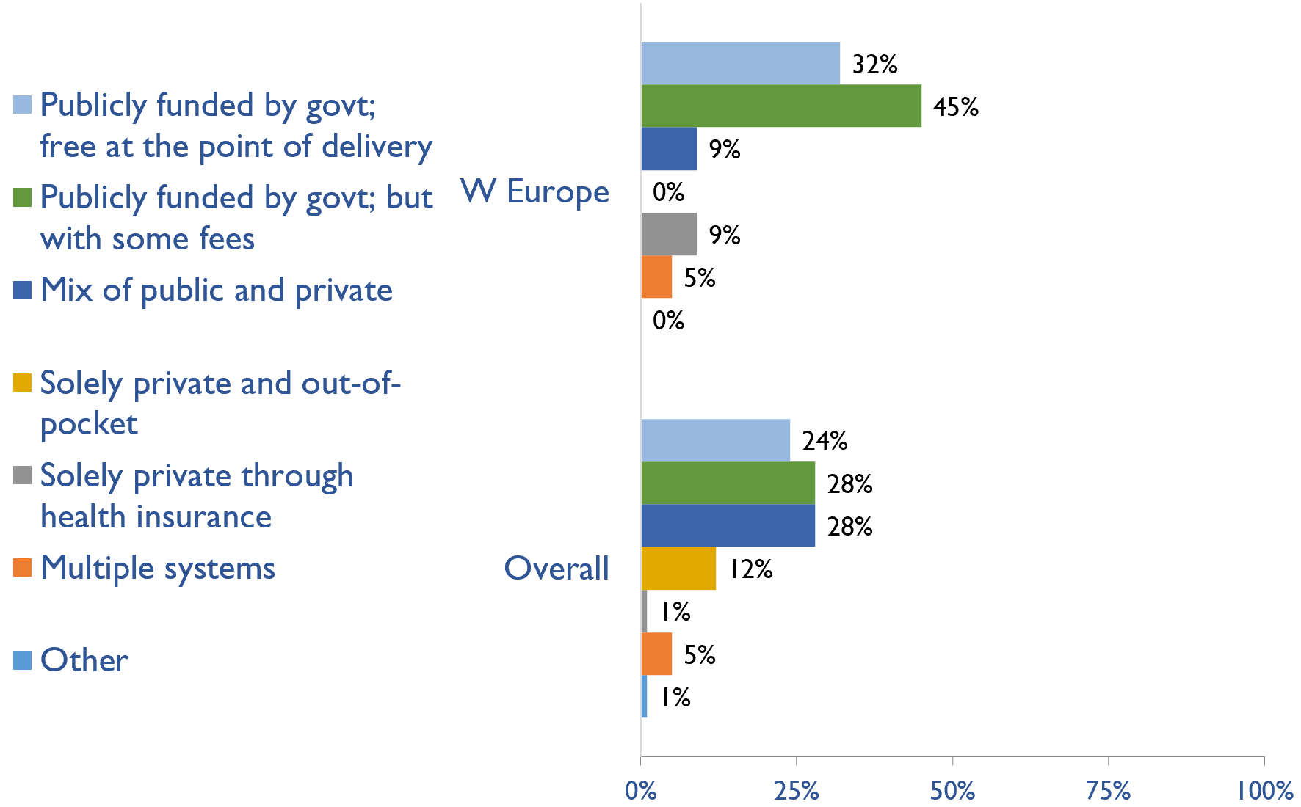
Funding for medications in all dialysis patients
Country | Publicly funded by govt; free at the point of delivery | Publicly funded by govt but with some fees at the point of delivery | Mix of public and private funding systems | Solely private and out-of-pocket | Solely private through health insurance providers | Multiple systems | Other
Andorra |  |  |  |  |  | X
Austria | X
Belgium |  | X
Denmark | X
Finland |  | X
France |  |  | X
Germany |  | X
Greece | X
Iceland |  | X
Ireland |  |  | X
Israel | X
Italy | X
Liechtenstein |  |  |  |  | X
Luxembourg |  | X
Malta | X
Netherlands |  |  |  |  | X
Norway |  | X
Portugal |  | X
Spain |  | X
Sweden |  | X
Switzerland | X
United Kingdom |  | X
X : Yes

Slide 35
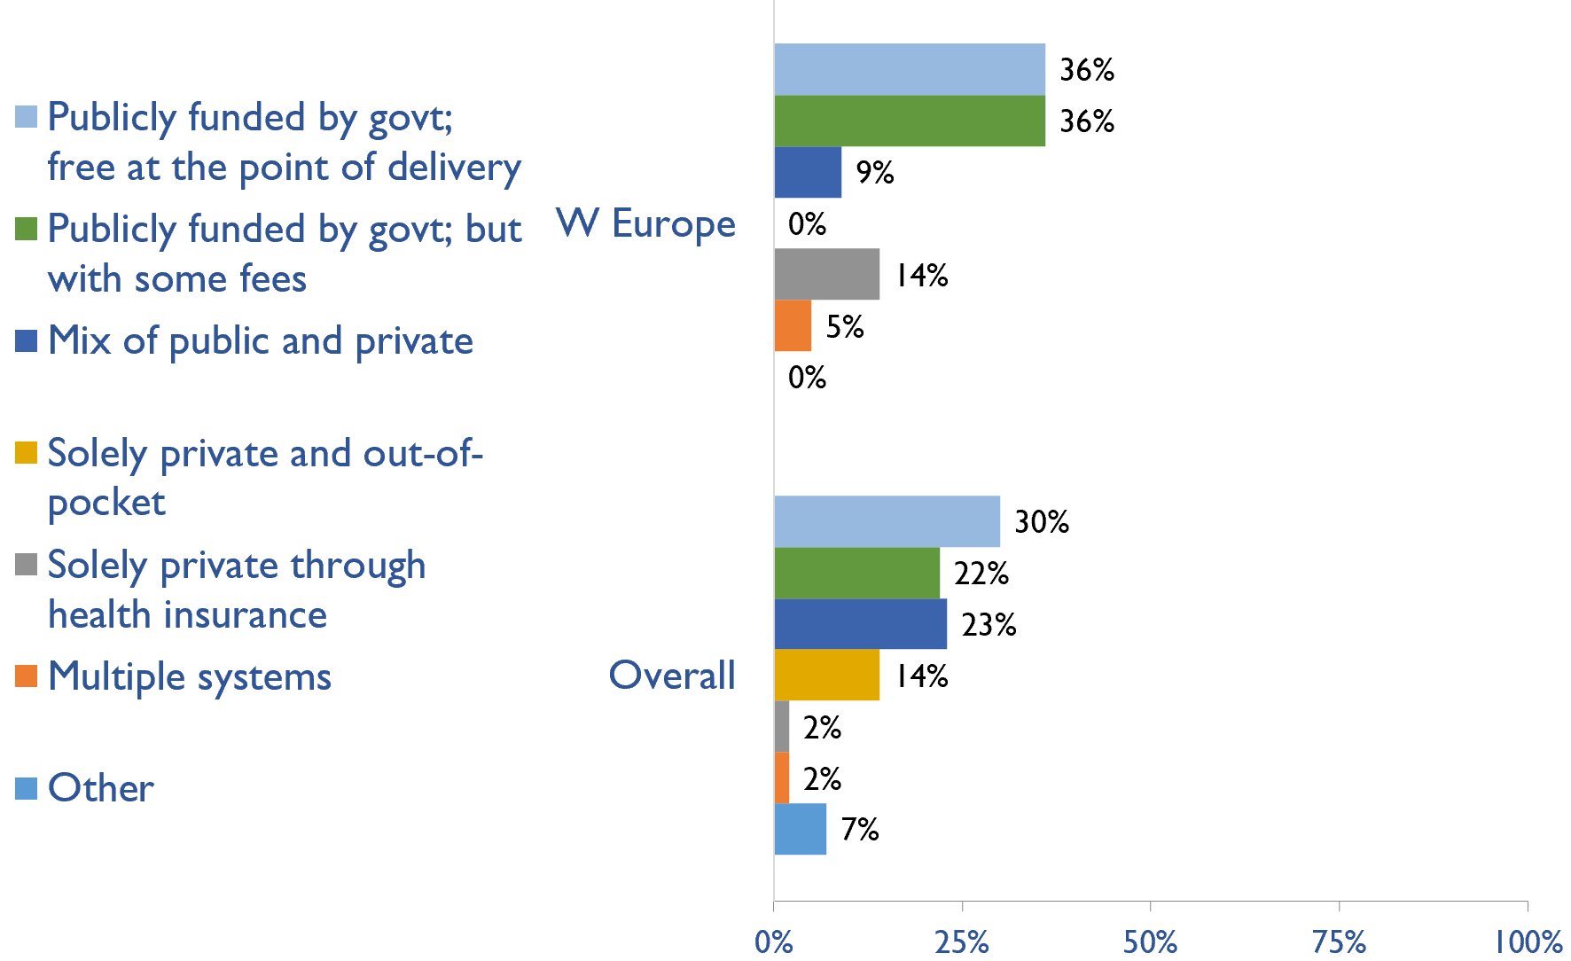
Funding for medications in all transplant patients
Country | Publicly funded by govt; free at the point of delivery | Publicly funded by govt but with some fees at the point of delivery | Mix of public and private funding systems | Solely private and out-of-pocket | Solely private through health insurance providers | Multiple systems | Other
Andorra |  |  |  |  |  | X
Austria | X
Belgium |  | X
Denmark | X
Finland |  | X
France |  |  | X
Germany |  | X
Greece | X
Iceland | X
Ireland |  |  | X
Israel | X
Italy | X
Liechtenstein |  |  |  |  | X
Luxembourg | X
Malta | X
Netherlands |  |  |  |  | X
Norway |  | X
Portugal |  | X
Spain |  | X
Sweden |  | X
Switzerland |  |  |  |  | X
United Kingdom |  | X
X : Yes

Slide 36
Availability of official registry
Country | CKD | Dialysis | Transplant | AKI | Conservative care
Andorra
Austria |  | X | X
Belgium |  | X | X
Denmark |  | X | X
Finland |  | X | X
France | X | X | X
Germany |  | X | X
Greece |  | X | X
Iceland | X | X | X |  | X
Ireland |  | X | X
Israel |  | X | X
Italy |  | X | X
Liechtenstein
Luxembourg | X | X | X
Malta |  | X | X
Netherlands |  | X | X
Norway | X | X | X
Portugal |  | X | X
Spain |  | X | X
Sweden | X | X | X | X | X
Switzerland |  | X | X
United Kingdom | X | X | X | X
X : Yes

Slide 37
Summary of Findings
In summary, the 2023 ISN-GKHA highlights several important findings for Western Europe.
KRT availability, access, and quality is high.
All countries in the region have HD and PD while KT was not available in Andorra, Liechtenstein, and Luxembourg.
Capacity to provide adequate frequency of HD i.e., three times weekly for 3 – 4 hours per session, was available in all (100%) countries.
Capacity to provide adequate PD exchanges i.e., three to four exchanges per day was available in 95% of countries.
Home HD was available in 77% of countries.
CKM is available and predominately chosen or medically advised.
Conservative kidney management (CKM) established through shared-decision making was available in 95% countries.
Choice restricted CKM (where resource constraints prevent or limit access) was only available in 6 (27%) countries.
Choice restricted CKM (where no resource constraints prevent or limit access) was also available in 9 (41%) of countries.
Government funding for kidney care services and medication is low.
Medications for ND-CKD are funded publicly and free in 4 (18%) countries.
Medications for dialysis patients (HD or PD) are free in 7 (32%) countries (with some fees in 45% of countries).
Medications for KT are funded publicly and free in 8 (36%) countries.
Most countries cover the cost of acute dialysis, chronic HD, chronic PD, and KT medications through public funds and free at point of delivery. Only Liechtenstein use solely private and out-of-pocket methods to cover the cost of these services.

Slide 38
Summary of Findings (cont’d)
Most have registries for advanced kidney disease, few for CKD or AKI
Availability of kidney registries varied across countries in the region.
Almost all countries in the region had a dialysis and KT registry.
Only France, Iceland, Luxembourg, Norway, Sweden, and UK had a ND-CKD registry.
Other registry forms (AKI and CKM) are largely unavailable in the region.
Some workforce limitations are present.
The median prevalence of nephrologists in Western Europe was 25.0 pmp (global median of 11.75 pmp). Liechtenstein had the highest density of nephrologists (100.7 pmp) while Ireland had the lowest (11.8 pmp).
Overall, median prevalence of nephrology trainees was 6.0 pmp (highest across all regions); Italy had the highest density of nephrology trainees (49.1 pmp) while Germany had the lowest (0.69 pmp).
For all categories of kidney care workforce, less than half of countries reported shortages in these categories.
Moderate advocacy for kidney disease in Western Europe.
Advocacy groups for CKD, kidney failure and KRT remains low in the region.

Slide 39
Implications
There are important implications to consider. Based on these survey findings, key recommendations to drive future activities for optimizing kidney care globally are proposed:
Increase health care financing for kidney failure prevention and management.
While resource limitations are an obvious barrier, focusing on preventing kidney failure through appropriate hypertension and diabetes management may be more cost-effective overall. Government funding to cover medication costs may allow more patients to treat earlier stage CKD, thereby preventing the need for more costly kidney failure treatment and the obvious burden this has on patients’ wellbeing.
Address workforce shortages through multidisciplinary teams and telemedicine
Shortages of nephrologists, surgeons, dialysis nurses, and other key allied health professionals were noted across most countries. Similarly, simply producing more nephrologists may not be feasible or appropriate, and sharing the workload across multiple providers will not only promote the use of multidisciplinary teams but further, allow for more and better care delivery across more patients. Telemedicine may help particularly in addressing gaps in care among rural patients and enhancing capacity through training programs such as ISN Fellowship, visiting ambassador programs, etc.

Slide 40
Implications (cont’d)
Incorporate the collection and reporting of quality indicators in kidney failure care.
Measuring and reporting on key quality indicators is an important driver in healthcare improvement. Ensuring facilities are supported with information systems that allow for the systematic measurement and reporting of indicators is a first key step to increasing the rate of monitoring among countries. Further, understanding if or how the collection and reporting of indicators are being used to improve care is needed.
Expand health information systems to prevent and manage kidney failure.
Similarly, good quality HIS are vital for kidney disease management within a country. A lack of data on disease prevalence, incidence, resource use, and quality of care limits government and provider ability to monitor and evaluate the care provided as well as predicts appropriate resource allocation so that sufficient facilities, medicines, and healthcare professionals are trained and available.
Promote kidney failure prevention and treatment by implementing policies, strategies, and advocacy, and mitigating barriers.
Lastly, policies and strategies are important for consistent approaches within a country for optimal care delivery, as well as for accountability, leadership, and knowledge exchange. Advocacy may help promote the increase of government prioritization and further, public awareness of how to prevent and manage kidney disease. Without acknowledging and mitigating barriers, it would be a challenge to achieve of successes out of these recommendations. Competing priorities and needs (for example, clean water supply and basic sanitation, maternal and child health, malnutrition, etc.) represent formidable barriers that can limit implementation of the recommended strategies in the region.

Slide 41







www.theisn.org
Global Operations Center
Americas Operations Center
Avenue des Arts 1-2
1210 Brussels, Belgium
340 North Avenue 3rd Floor Cranford, NJ 07016-2496, United States
+ 32 2 808 04 20
+1 904 345 0866
info@theisn.org
info@theisn.org
Follow us

